Slide 1
Millbrook Magnet High School
An International Baccalaureate School
What will You be?

Slide 2
Our Story
Millbrook High School was established in 1923 and moved to its current location in 1967.
Since that time, we have added two new buildings to our campus, launched a JROTC program, attained International Baccalaureate authorization and joined the Global Schools Network. MHS offers a traditional high school experience mixed with IB concepts. Explore with us!
Notes:
Get History- What else do we need?

Slide 3
Millbrook High School
Presents:
What is a Wildcat?
Who Are We?
Why Millbrook?
Schedule
The International Baccalaureate
The Arts at Millbrook
JROTC
Digital Media Academy
Traditional Academics
Life at Millbrook
For more information, click a category above
HOMEBASE
Choose your destination to the right.
Click HOMEBASE on the top of each slide to return back to this page
Notes:
Feel Free to change.. IF YOU ADD ANOTHER SLIDE, PLEASE DUPLICATE ONE OF THE BLANK ONES SO THAT THE HOMEBASE LINK IS INCLUDED ON ALL SLIDES

Slide 4
Who Are We?
HOMEBASE
We are a community of individuals that share a passion for academic excellence, for service to our community, for athletic success- for Millbrook. We have a commitment to supporting our students, enabling them to have the tools needed to build better communities and a better world.
What is a Wildcat?

Slide 5
Who Are We?
HOMEBASE
Millbrook Magnet High School serves over 2300 students in the heart of North Raleigh. We offer the most rigorous paths of study while still providing rich opportunities for students to excel in the Arts, Athletics, Business, Technical Education and Digital Career Preparation in a traditional high school setting. Additionally, we are:
Experienced
Rigorous
Caring
86% of teachers with over 4-years of teaching experience
91% of seniors take IB, AP, or honors courses
Students complete numerous hours of community service per year
Notes:
Good job with this slide

Slide 6
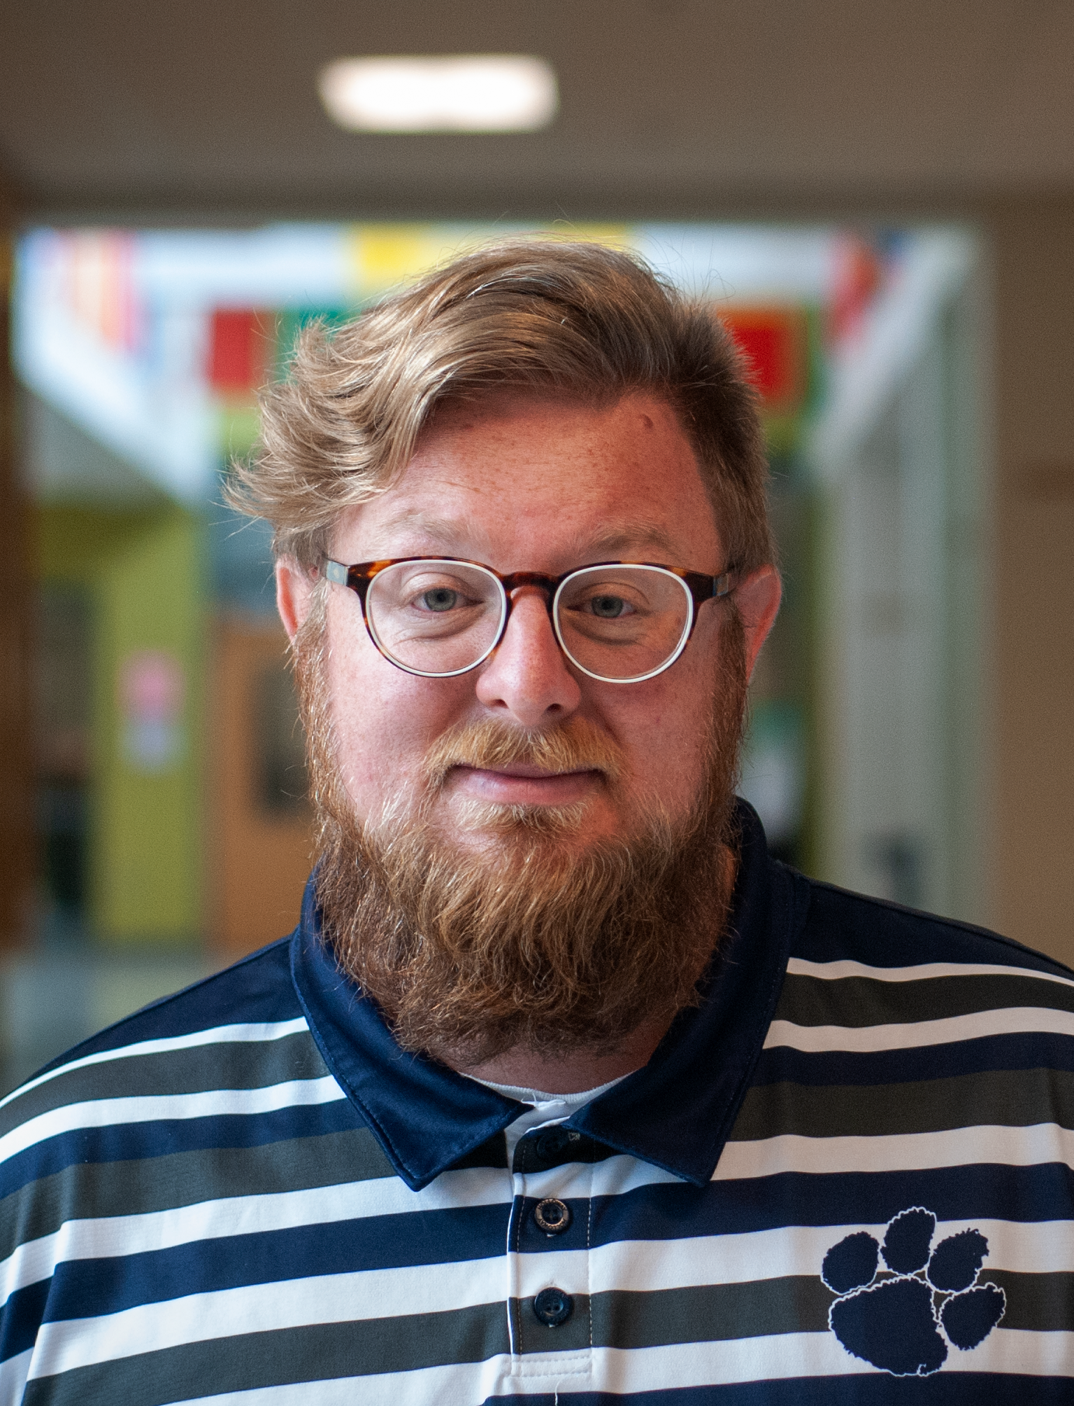
Who Are We?
HOMEBASE
Mr. Patton grew up an Air Force brat but was fortunate to attend UNC-Chapel Hill for two degrees. He is an avid saxophone player and taught band before moving into administration in 2014. He has been fortunate to live and study overseas in the UK, Switzerland, and South Korea.
Charles Patton- Assistant Principal

Slide 7
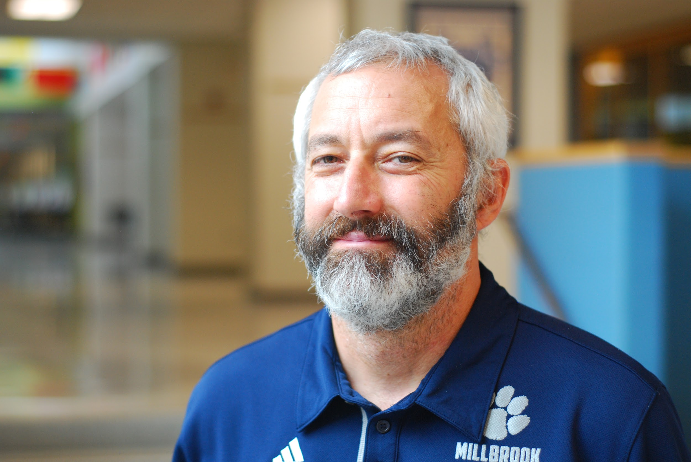
Who Are We?
HOMEBASE
I am originally from Clemson, SC. I earned my Bachelor's Degree in Philosophy from Brandeis University in 1991. After a year living in Beijing, China, teaching English to Chinese graduate students, I returned to school and earned my MEd. in Teaching and Curriculum from Harvard University.
Loren Baron- Diploma Programme Coordinator
Notes:
You are to introduce yourself here… who are you? Not what you do

Slide 8
Who Are We?
HOMEBASE
Before coming to Millbrook, I taught for 15 years in two IB Diploma Programmes in Maryland and North Carolina. I am also an IB Workshop Leader, training teachers in Economics and Theory of Knowledge.
Loren Baron- Diploma Programme Coordinator

Slide 9
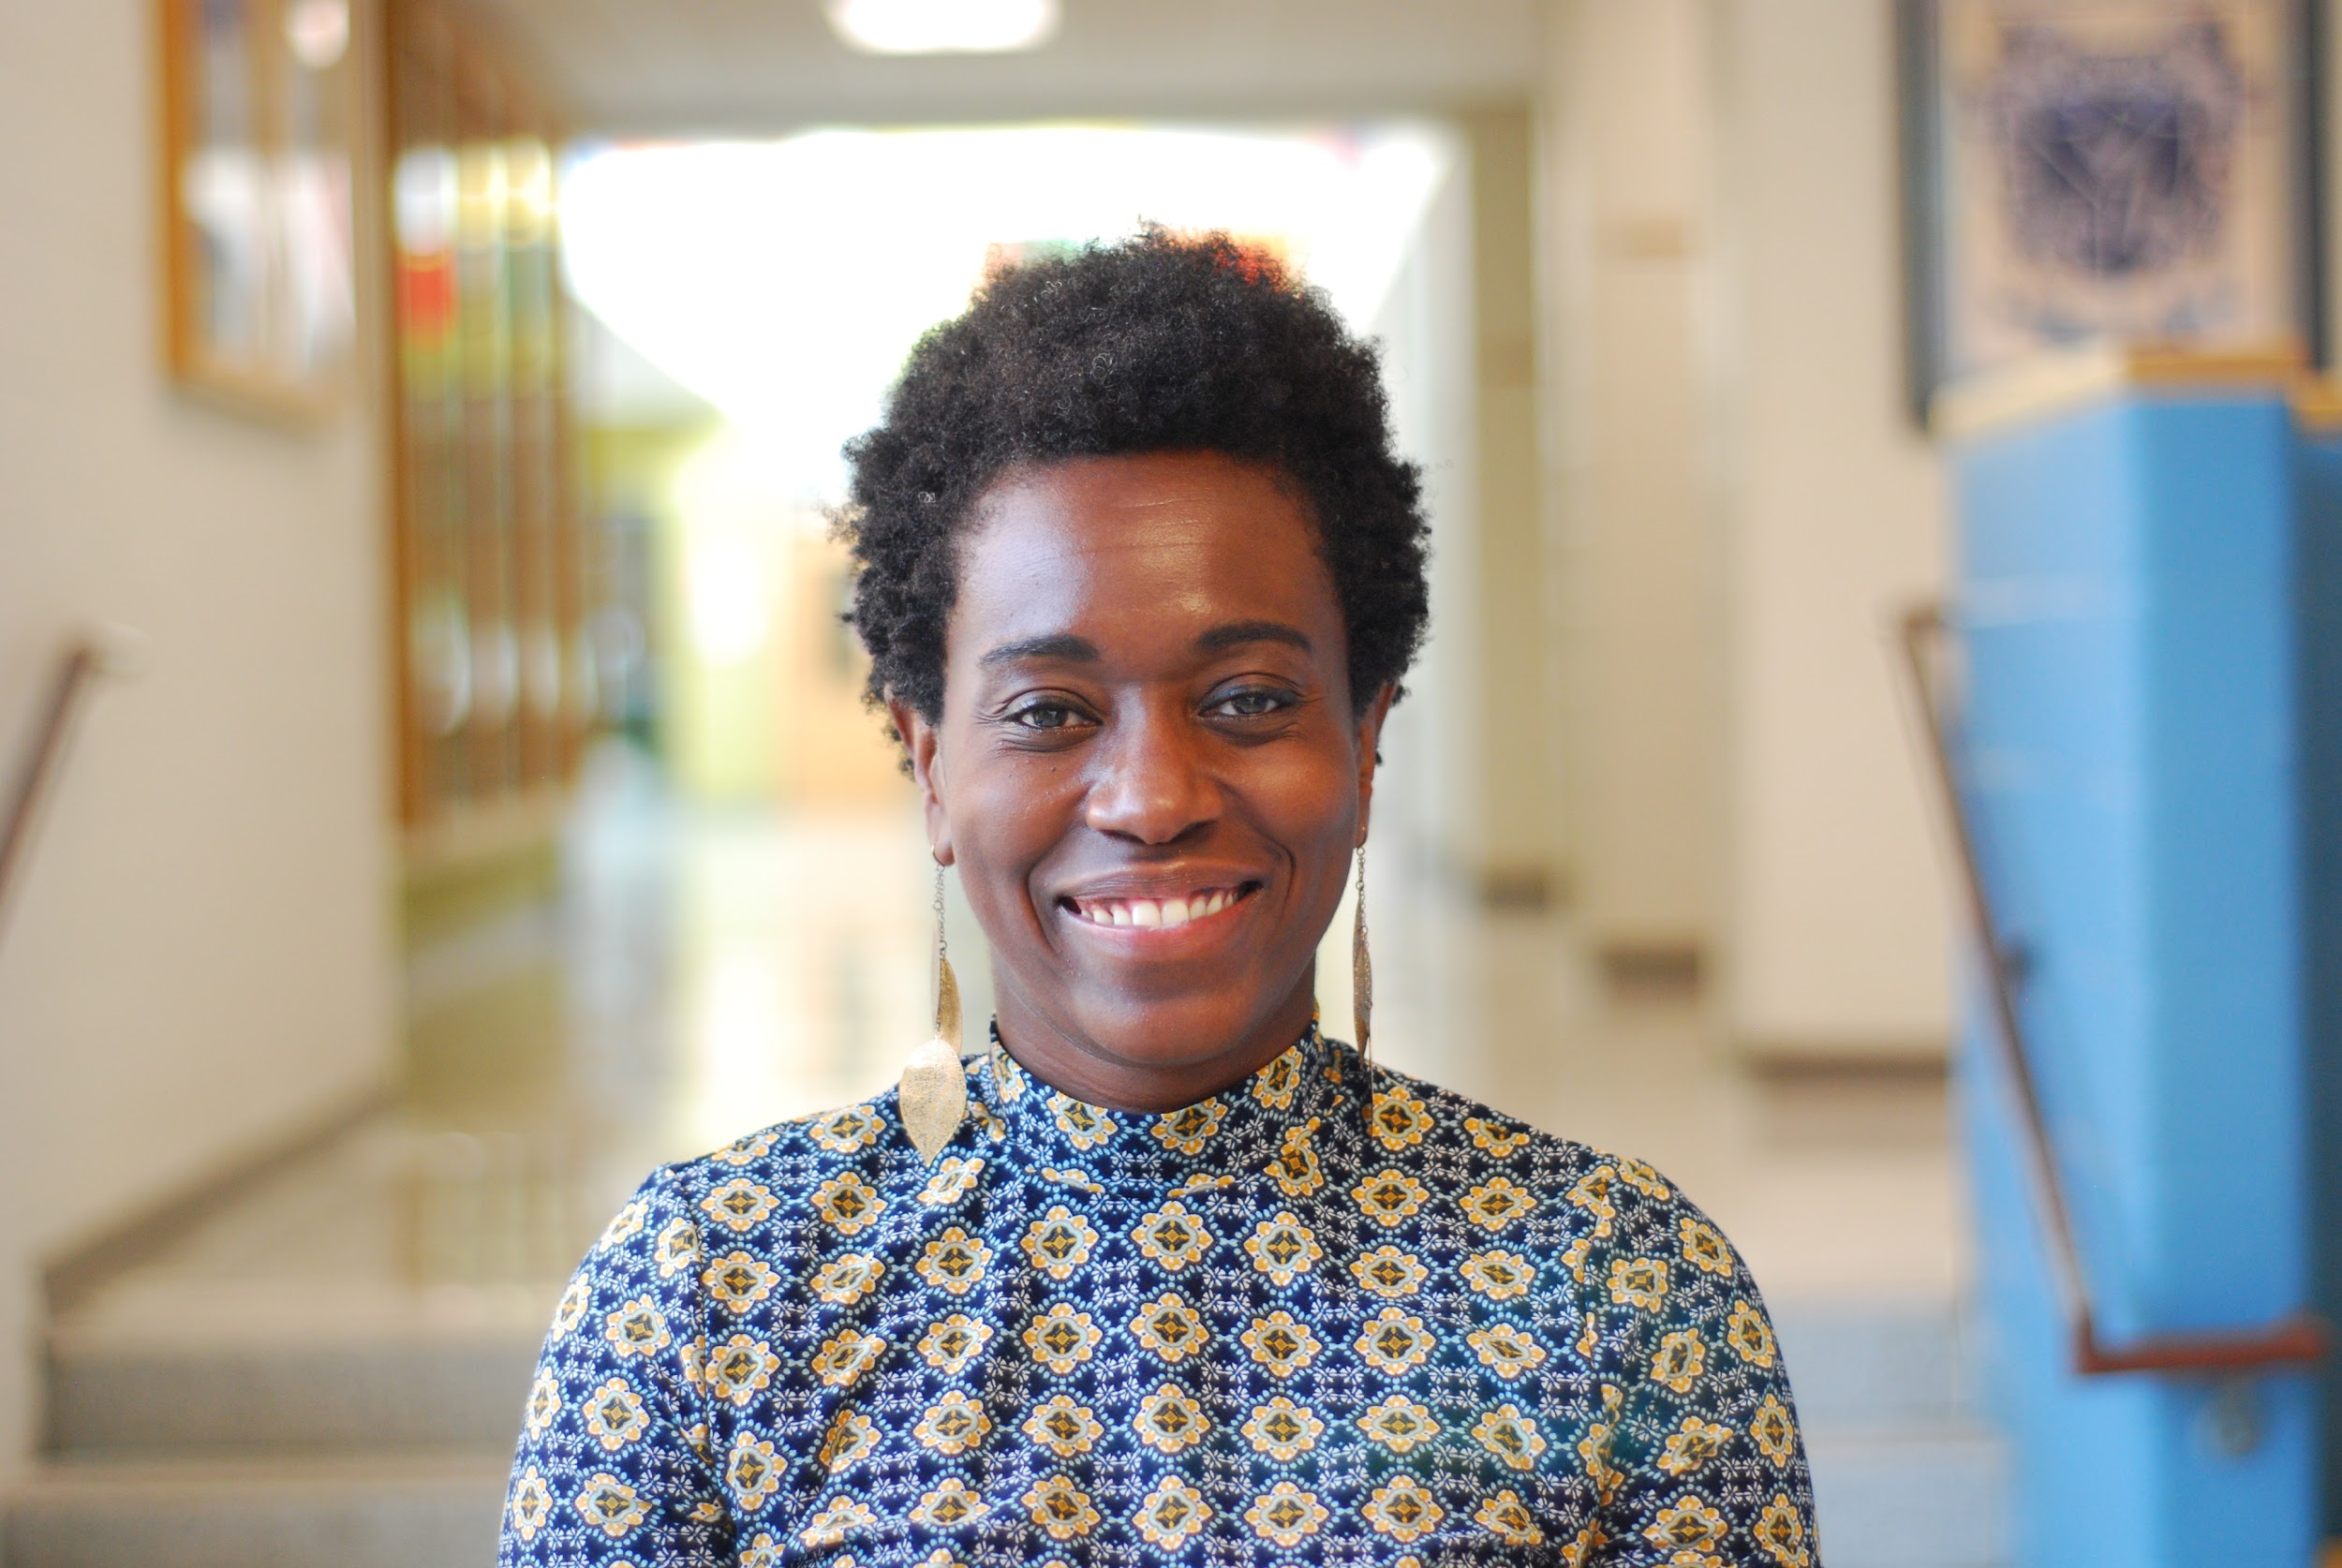
Who Are We?
HOMEBASE
Hi!! My name is LaShonda Haddock, and I am from the great state of NC! (Pollocksville anyone?) I received my bachelor’s degree from the University of NC at Charlotte and my M.A. from Gardner-Webb University. I have been an educator in my home state of NC for over 17 years and this is my 3rd year at Millbrook.
LaShonda Haddock- Middle Years Programme Coordinator

Slide 10
Who Are We?
HOMEBASE
16 of my 17 years in education were as a classroom teacher, telling the story of our country's history. This year is my 1st year as the MYP Coordinator at MHS. I am excited to help families learn more about our school, community, and the principles of the IB Programme! I look forward to helping you and your child on this journey together!
LaShonda Haddock- Middle Years Programme Coordinator

Slide 11
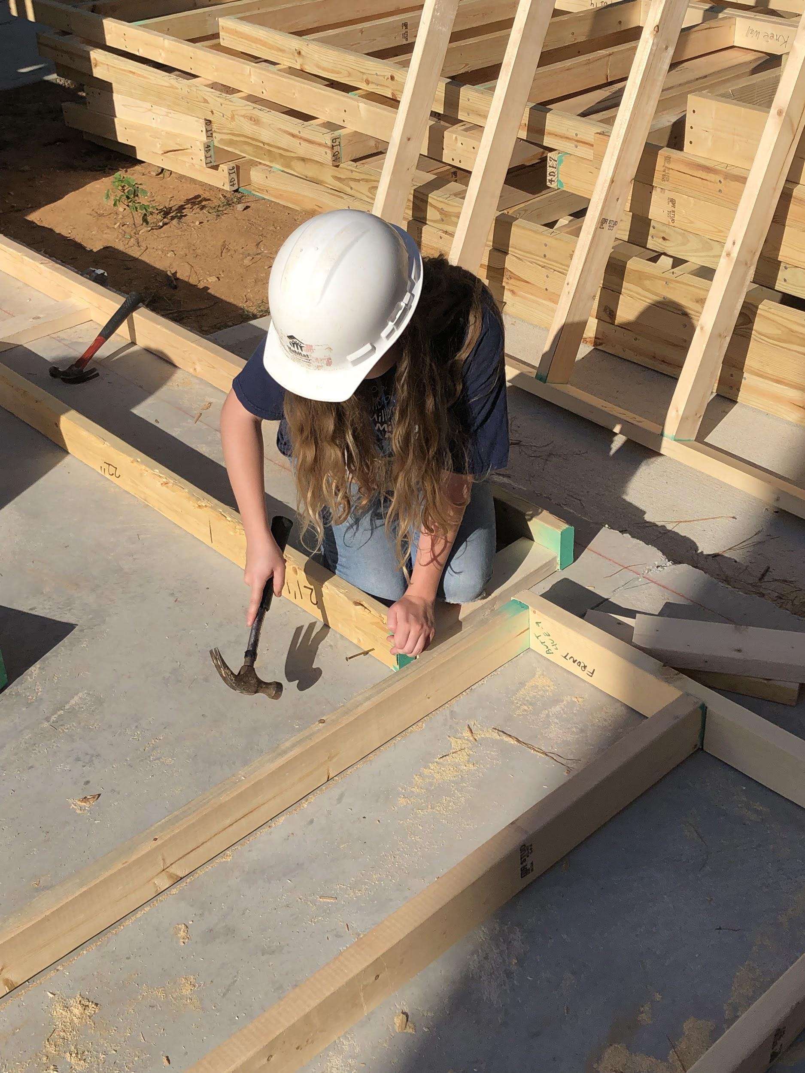
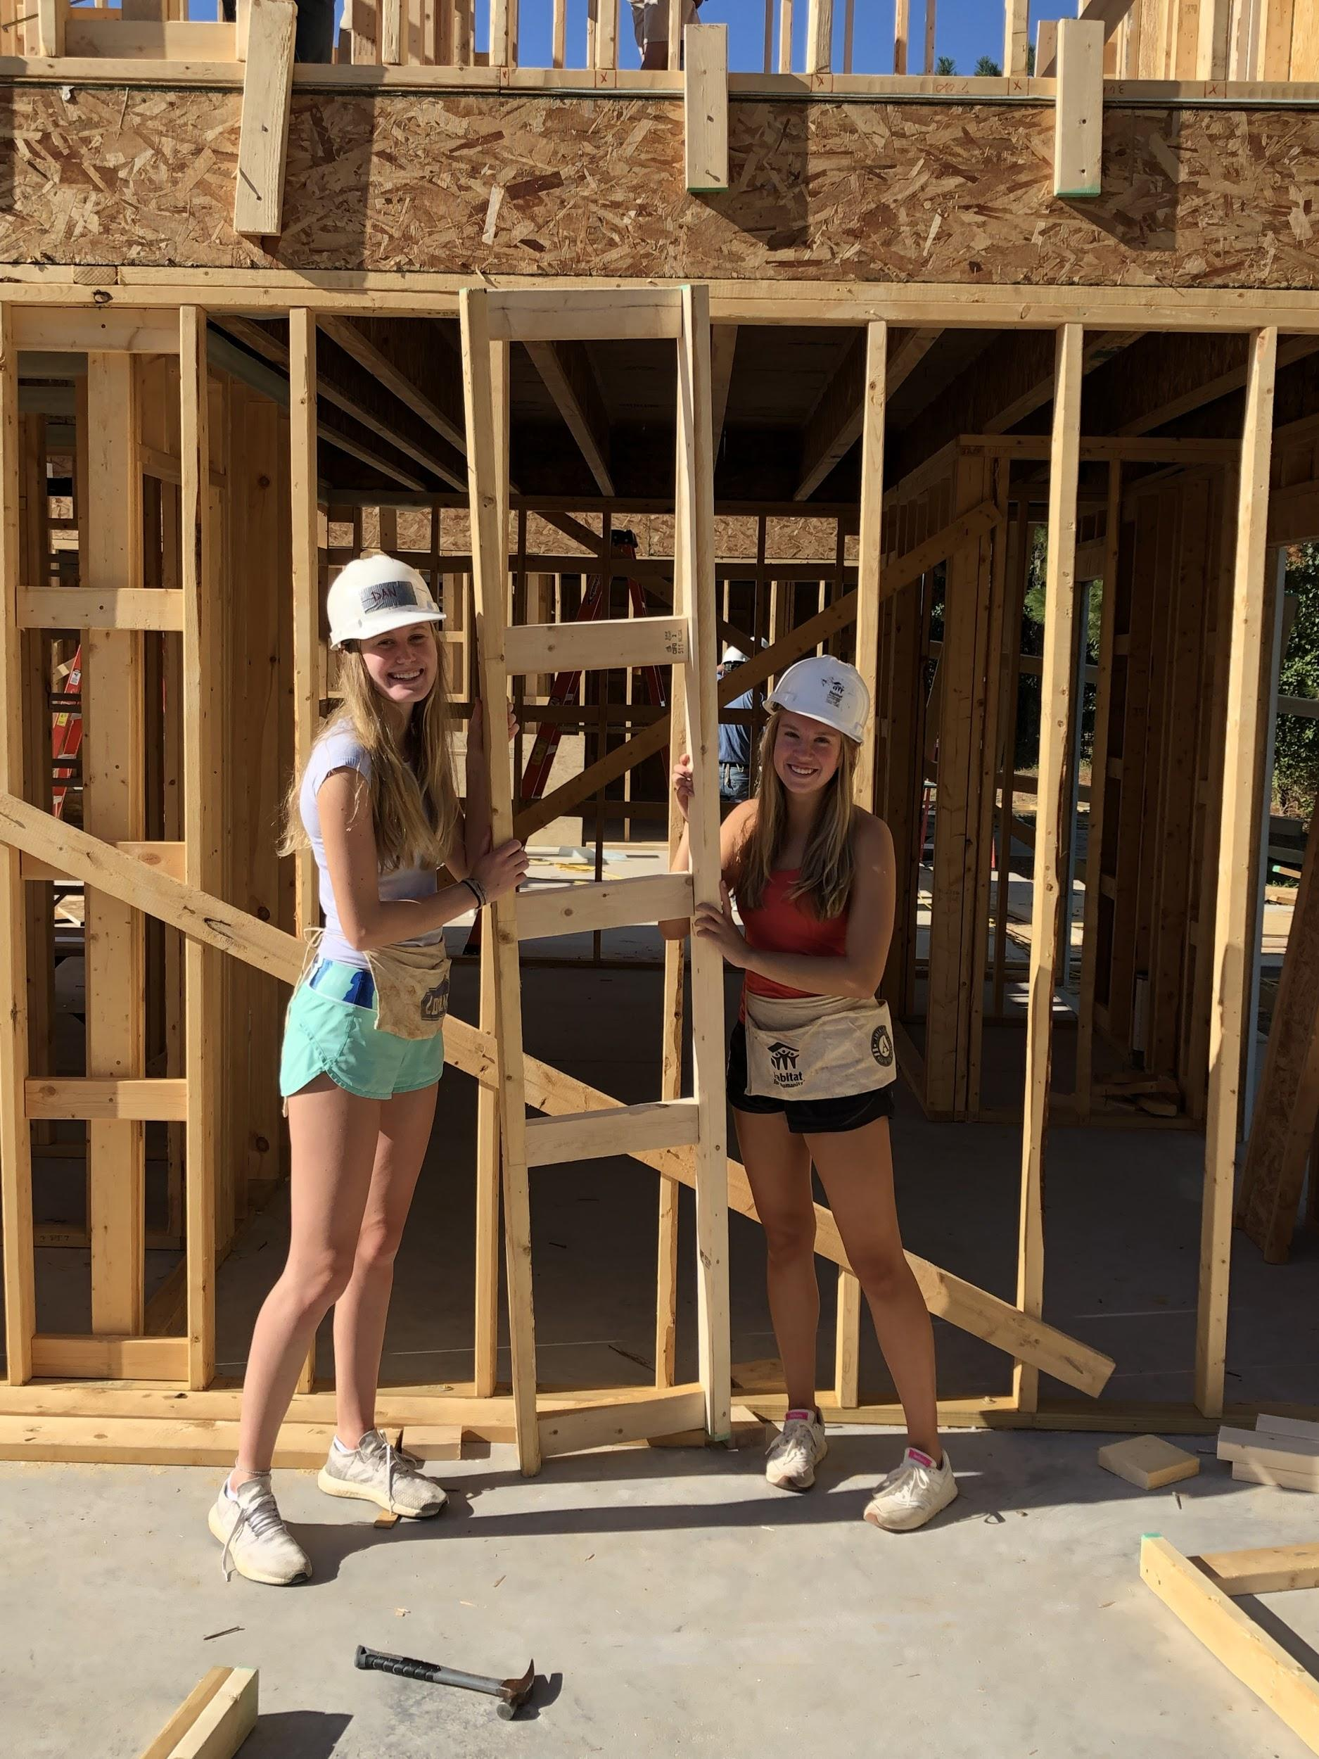
THE IB PROGRAMME AT MILLBROOK
HOMEBASE
What is IB?
The International Baccalaureate aims to develop inquiring, knowledgeable and caring young people who help to create a better and more peaceful world through intercultural understanding and respect.
https://ibo.org/benefits/why-the-ib-is-different/

Slide 12
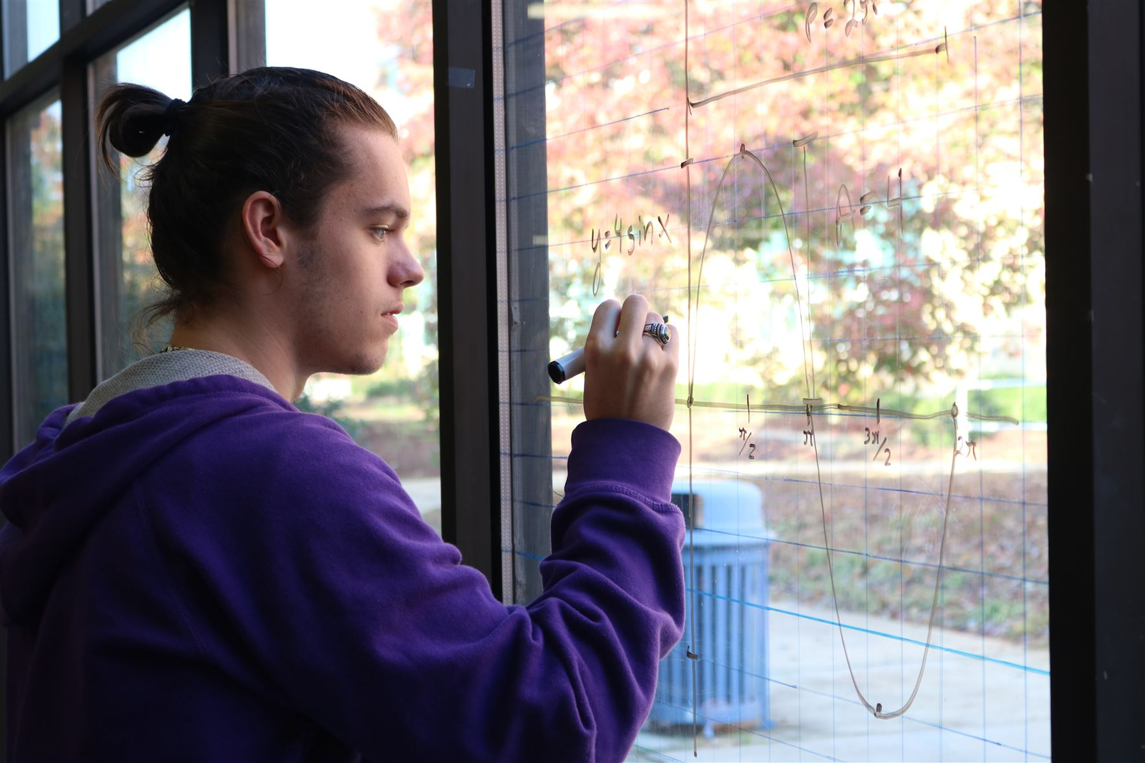
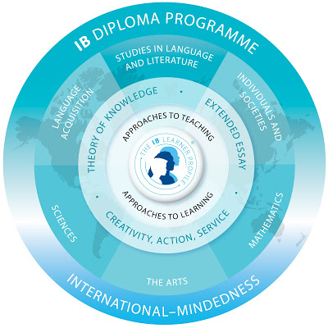
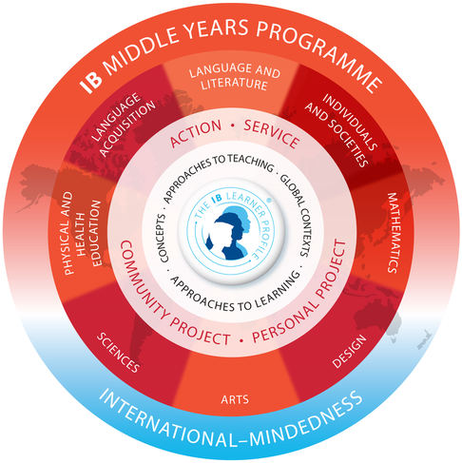
HOMEBASE
Millbrook has two unique IB programmes, the Middle Years Programme (MYP) and the Diploma Programme (DP). These programs complement one another to give students a unique educational environment that will allow them to develop academically, socially, and emotionally.

Slide 13
Why IB?
HOMEBASE
Middle Years Program
A whole-school ( all 9th and 10th) programme that:
encourages international-mindedness
encourages a positive attitude towards learning
supports the development of communication skills
emphasizes the development of the whole student
allows students to demonstrate acquired knowledge through the Personal Project
Diploma Programme
The IB Diploma Programme is designed as an academically challenging and balanced programme of education in grades 11 and 12
Requires students to engage in community activity and research as an extension of their classroom experience.
Taught during the junior and senior years and has gained recognition and respect from the world's leading universities.

Slide 14
IB Foundations
HOMEBASE
Learner Profile
The foundation of our IB Programme. A student centered philosophy which encourages students to become well-rounded, life-long learners
Key Concepts
The 16 concepts that we use to connect what we teach to other disciplines and to the real world
Approaches to Learning
Supports the IB belief that a large influence on a student’s education is not only what you learn but also how you learn.
Notes:
Put videos here- Service and family?

Slide 15
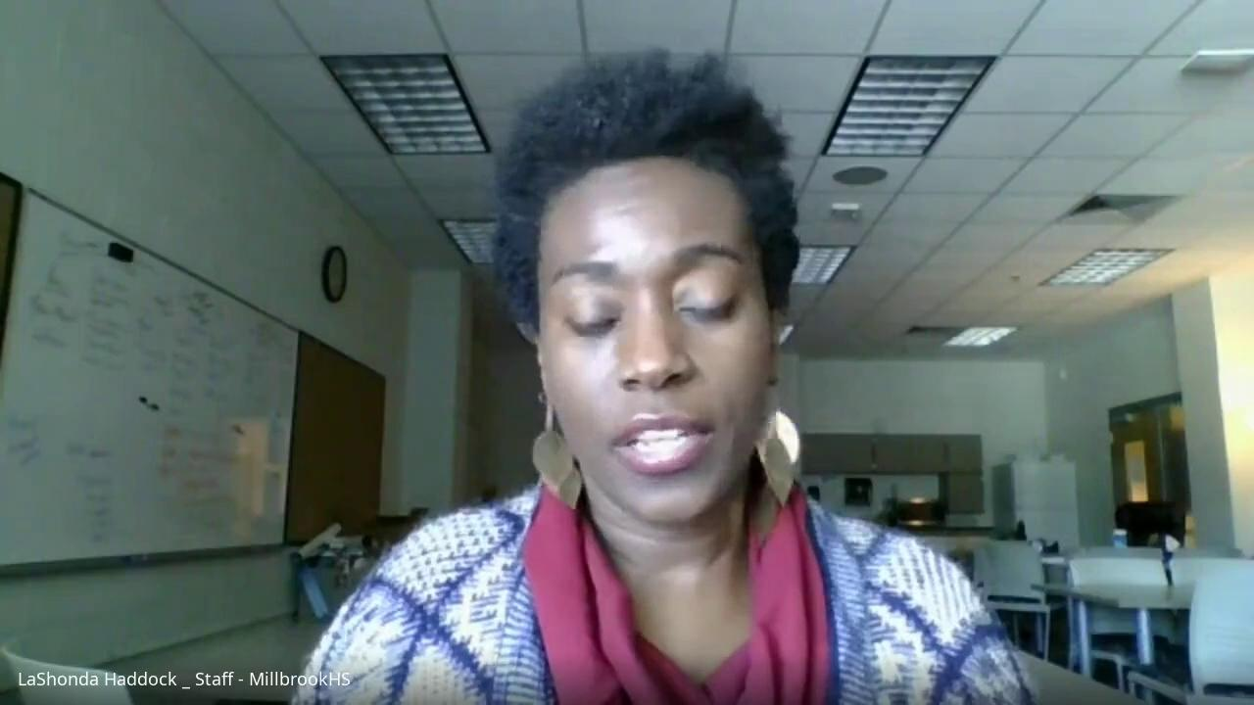
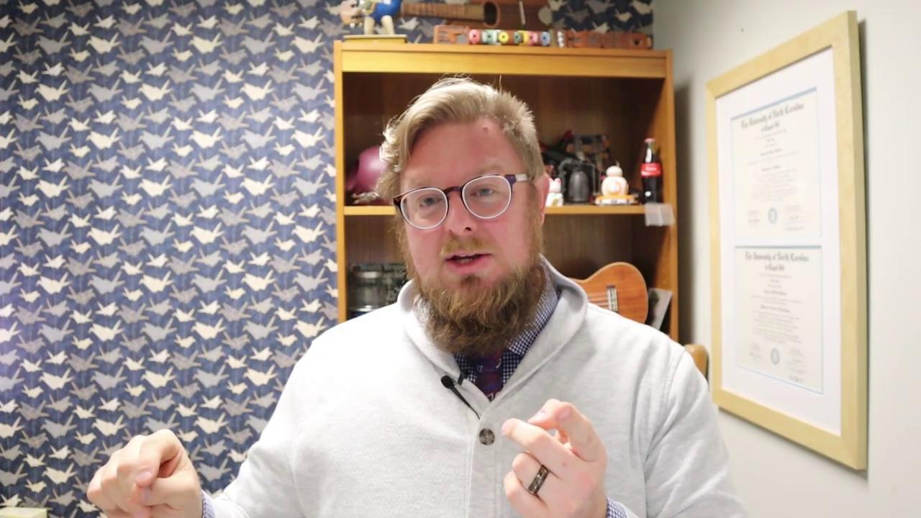
IB Programme Principles
HOMEBASE
Learner Profile- Quiz
Key Concepts

Slide 16
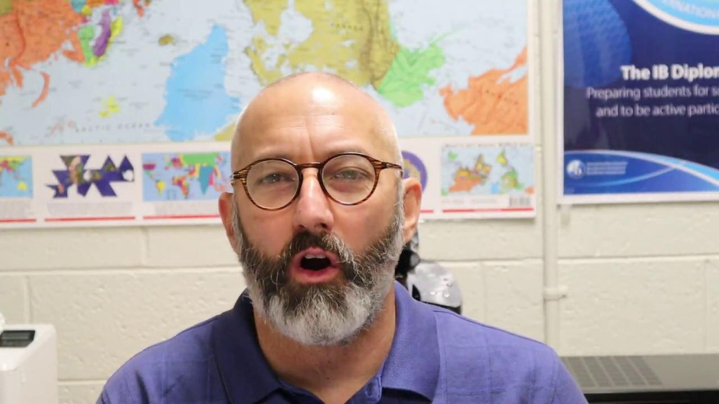
IB Programme Principles
HOMEBASE
Approaches to Learning

Slide 17
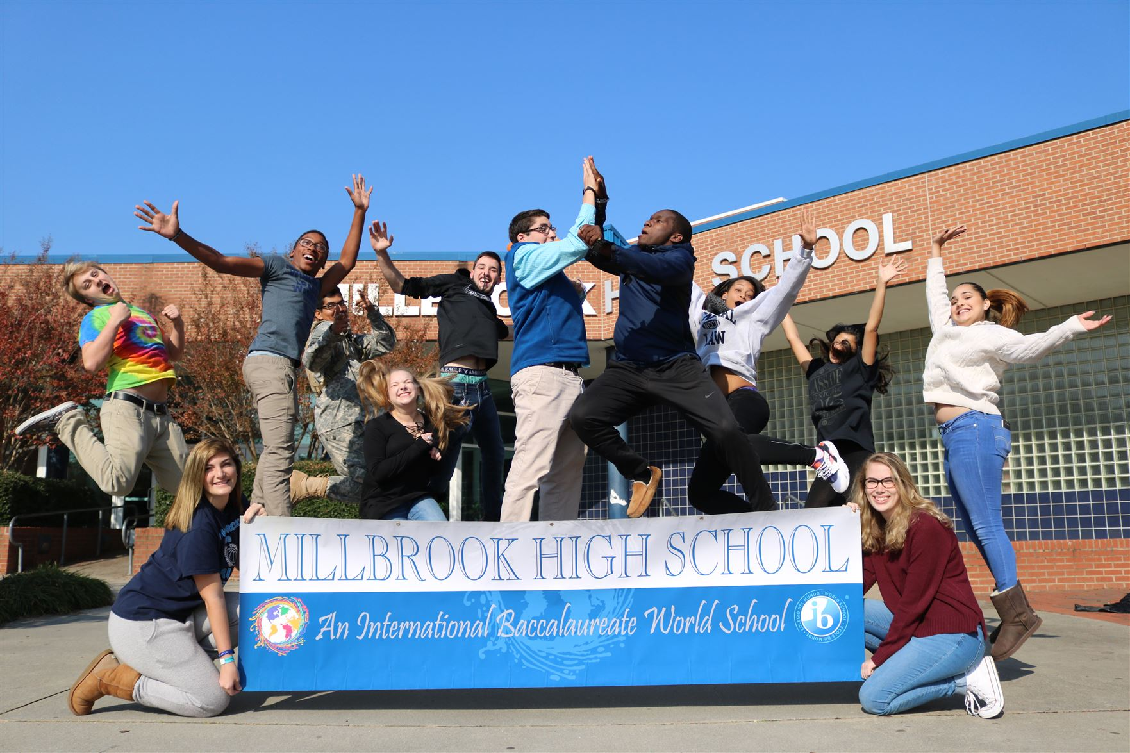
Why IB?
HOMEBASE
The IB's programmes are different from other curricula because they:
encourage students of all ages to think critically and challenge assumptions
develop independently of government and national systems, incorporating quality practice from research and our global community of schools
encourage students of all ages to consider both local and global contexts
develop multilingual students.
https://ibo.org/benefits/why-the-ib-is-different/

Slide 18
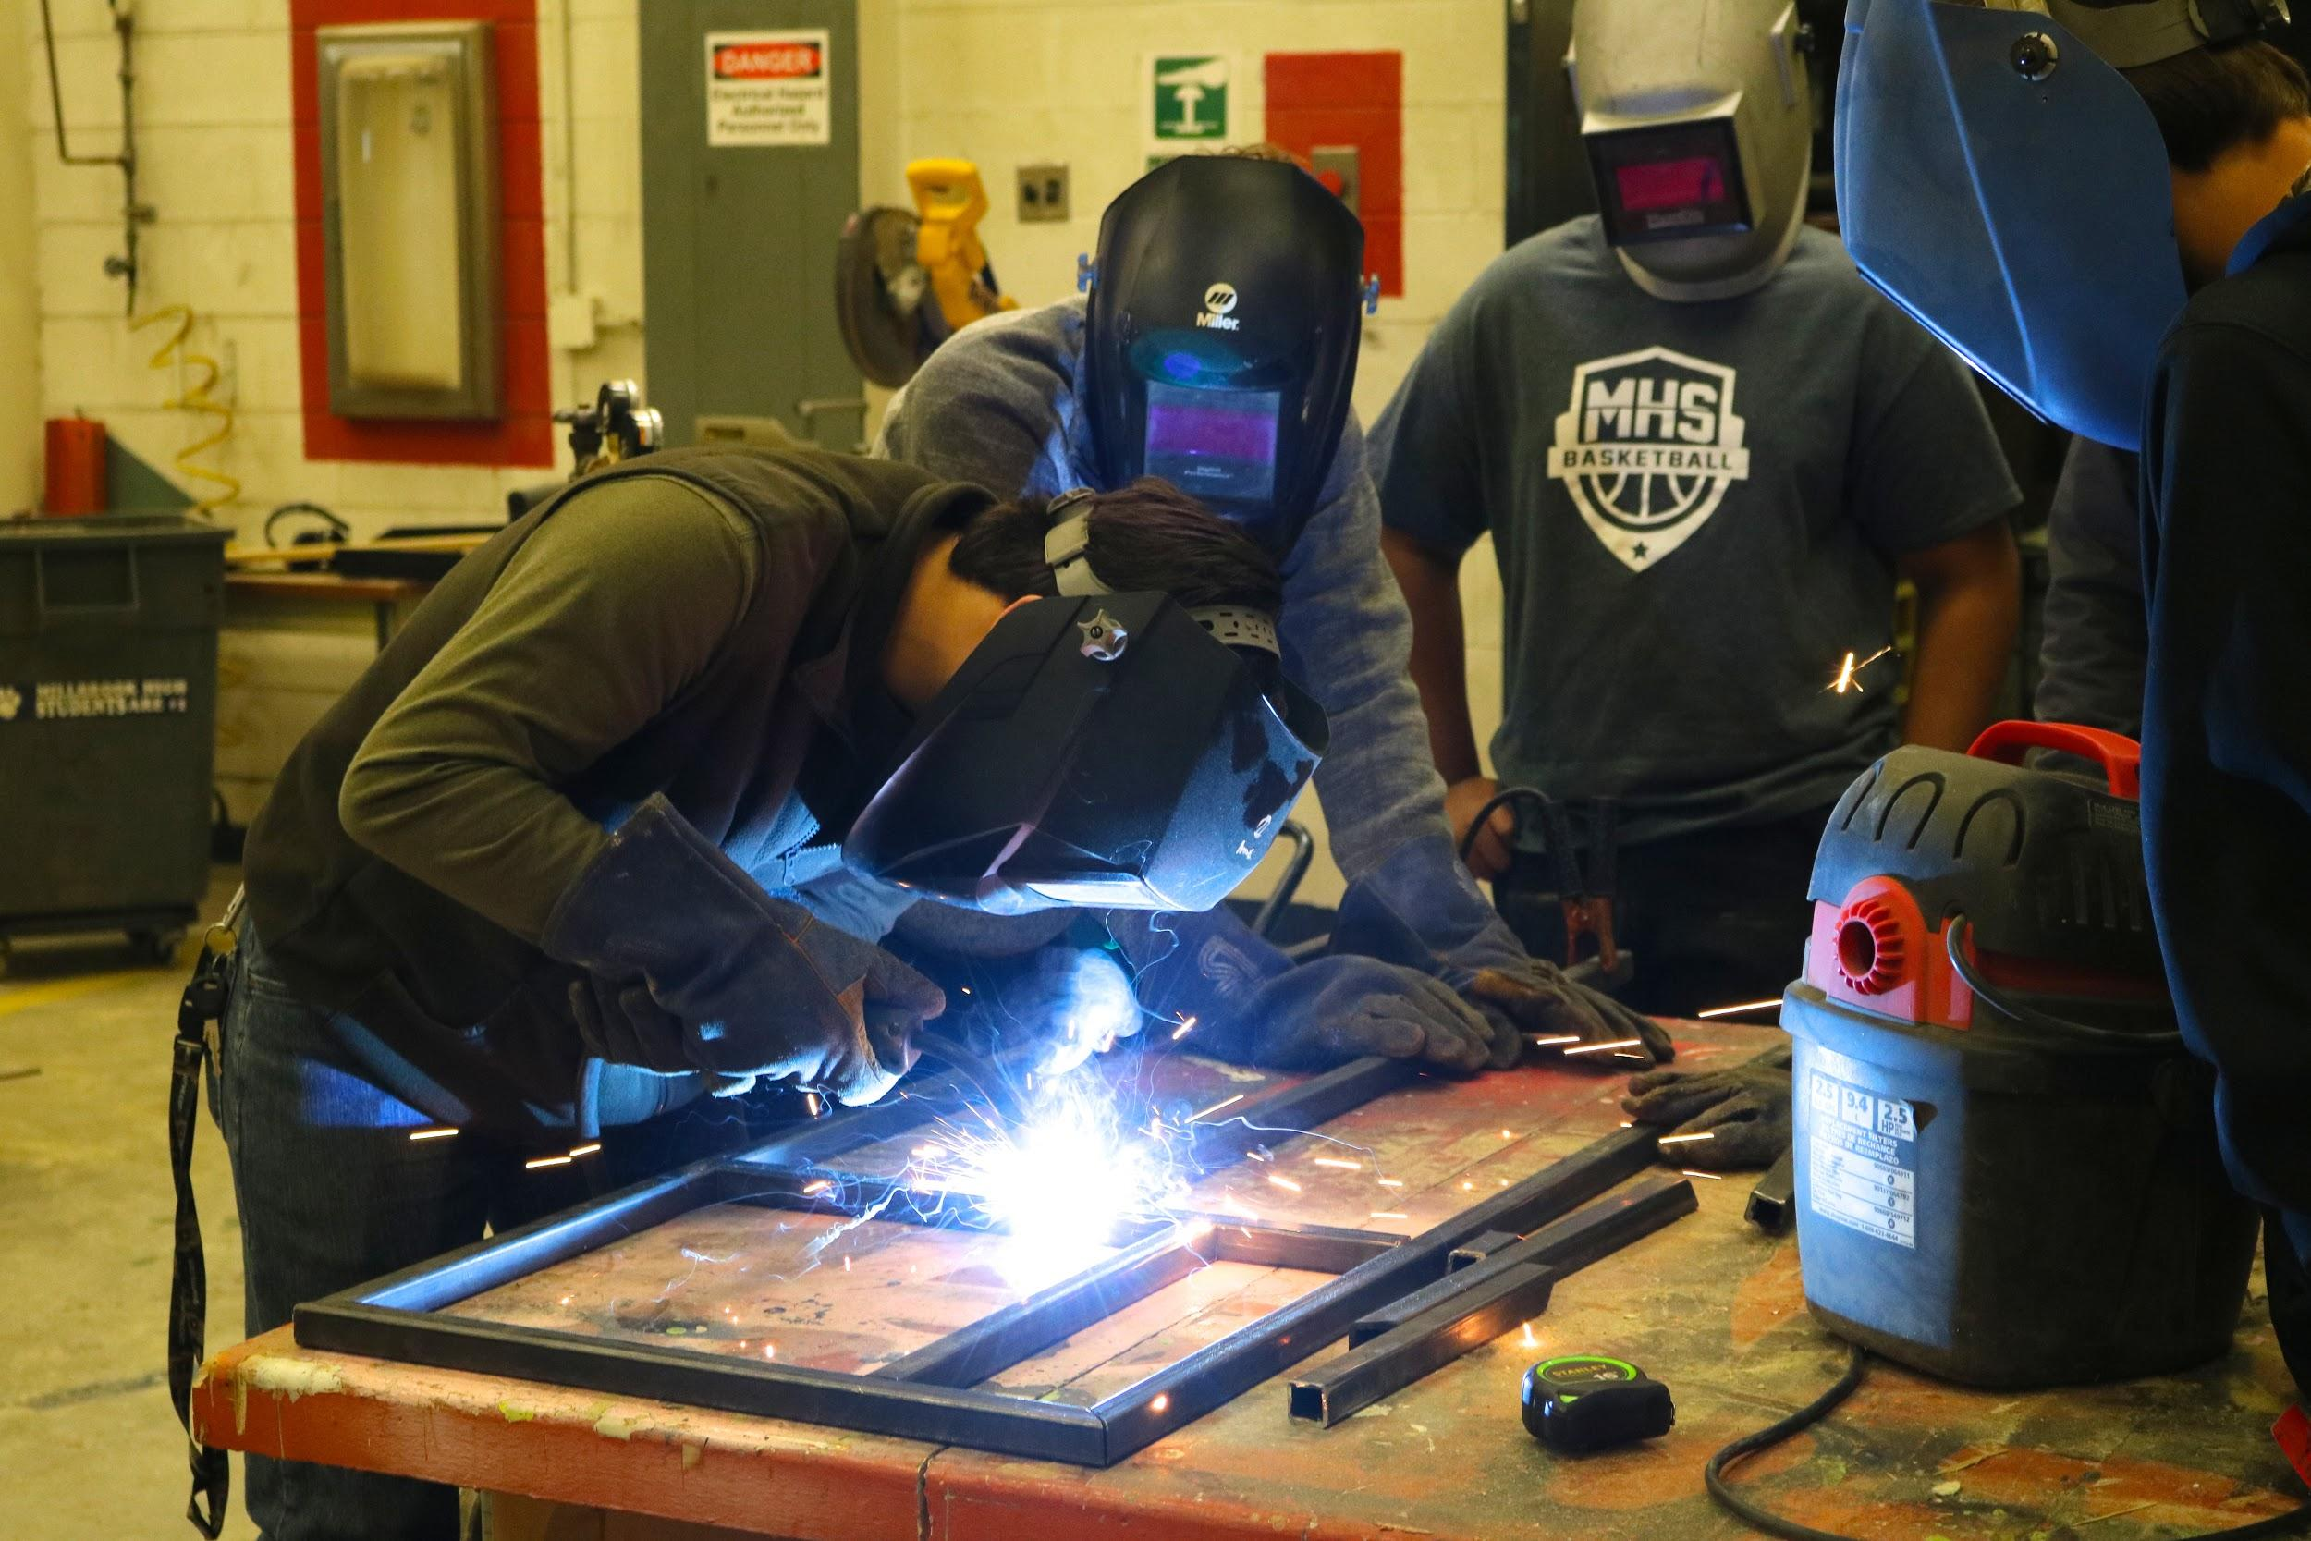
Why IB?
HOMEBASE
Throughout all IB programmes, students develop approaches to learning skills and the attributes of the IB learner profile.
Students are able to take responsibility for their own learning and understand how knowledge itself is constructed.
IB programmes also encourage students to be active in their communities and to take their learning beyond academic study.
https://ibo.org/benefits/why-the-ib-is-different/

Slide 19
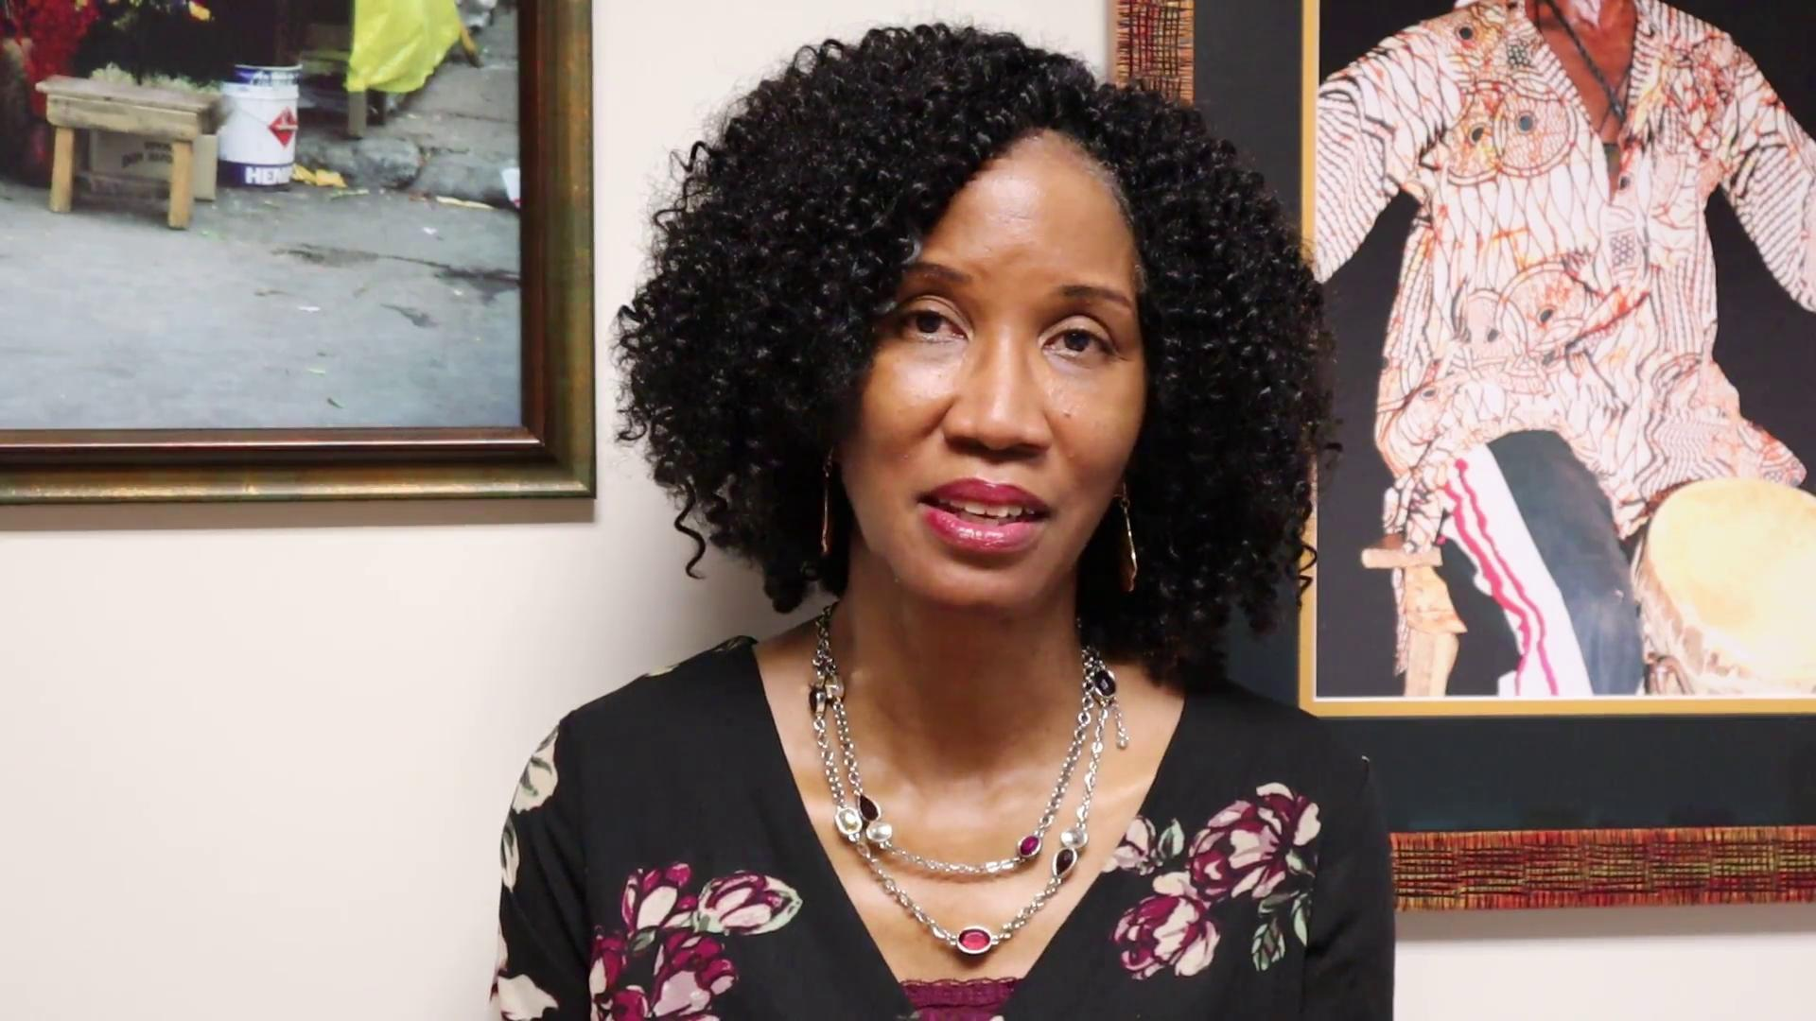
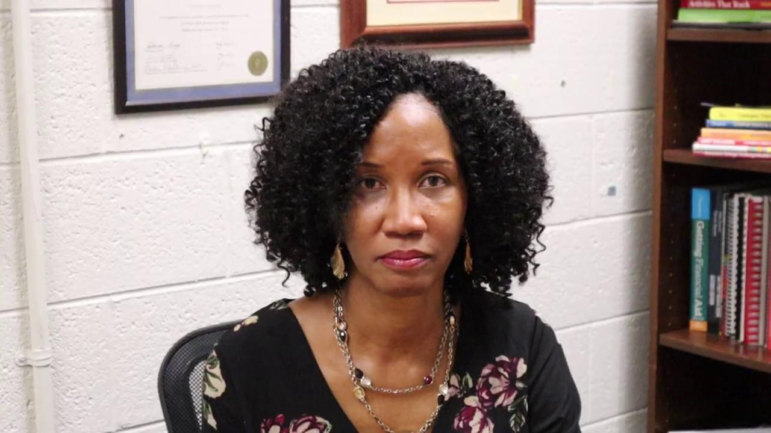
Our Teacher and Staff Voices
Vanessa Barnes- Dean of Students
HOMEBASE
Notes:
Edit these together?
First video starts at 1:41 to 4:09

Slide 20
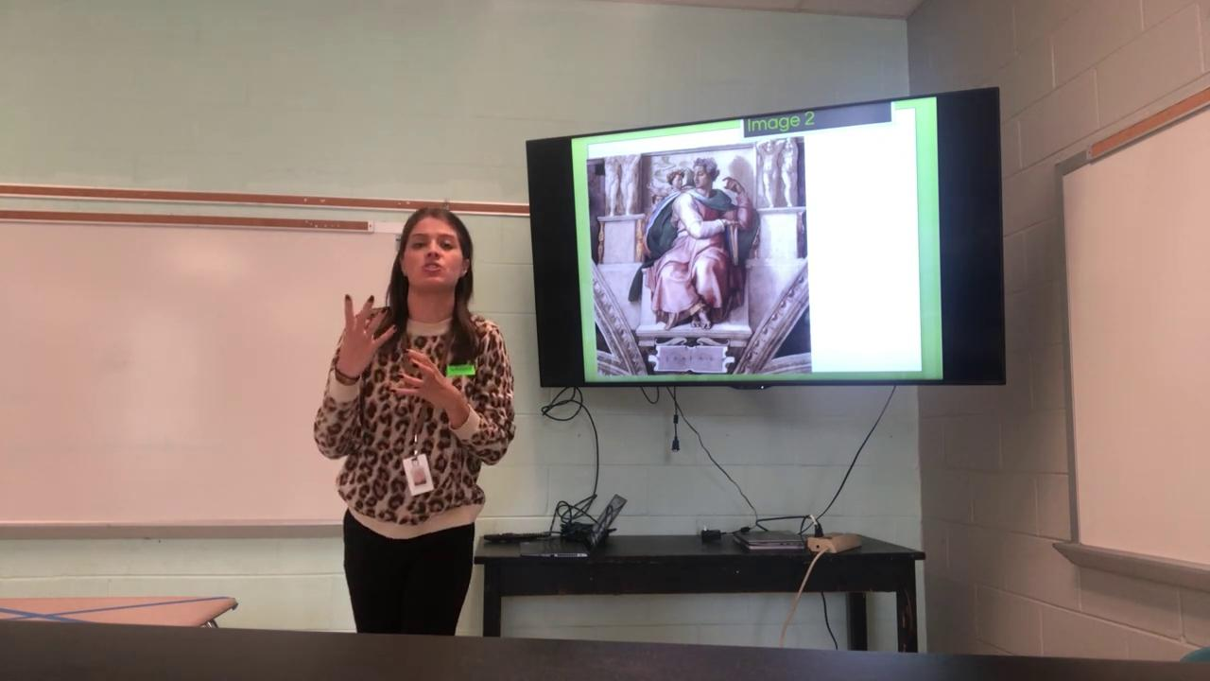
Our Teacher and Staff Voices
HOMEBASE
Jamie Delp Perspectives- English 10
Laura Kost Teaching- English 9

Slide 21
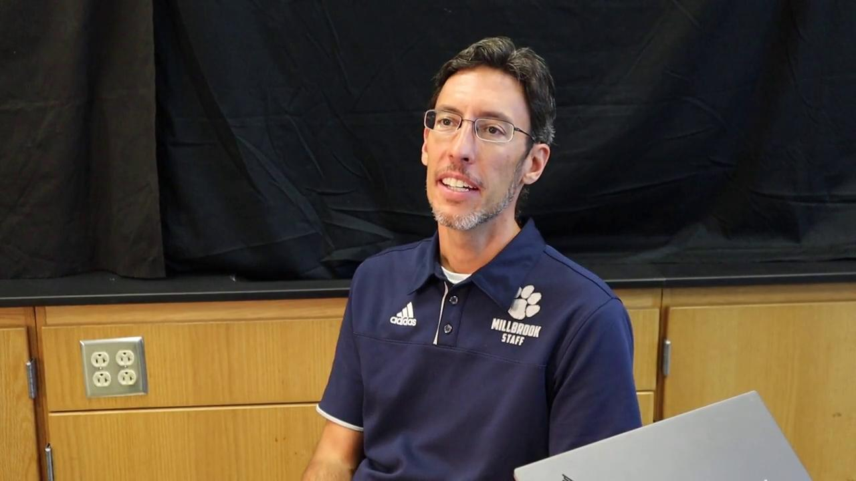
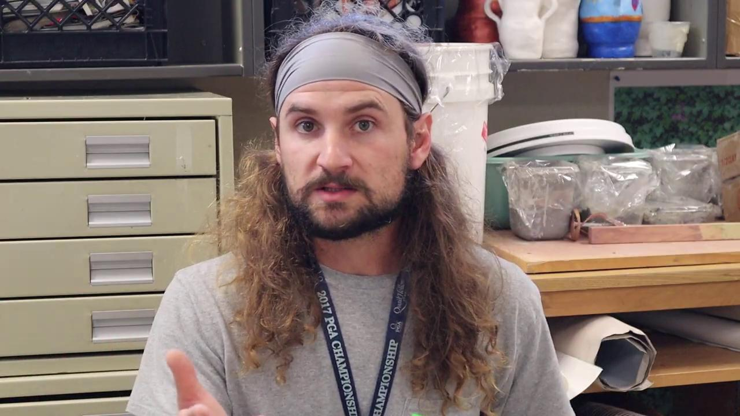
HOMEBASE
Mark Harmon- DP Science
Josh Davis- DP Art
Notes:
I would like the Harmon Video here.. It needs to be edited

Slide 22
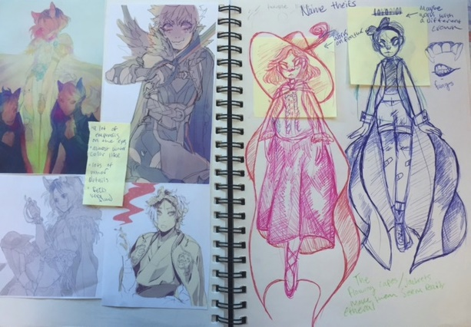
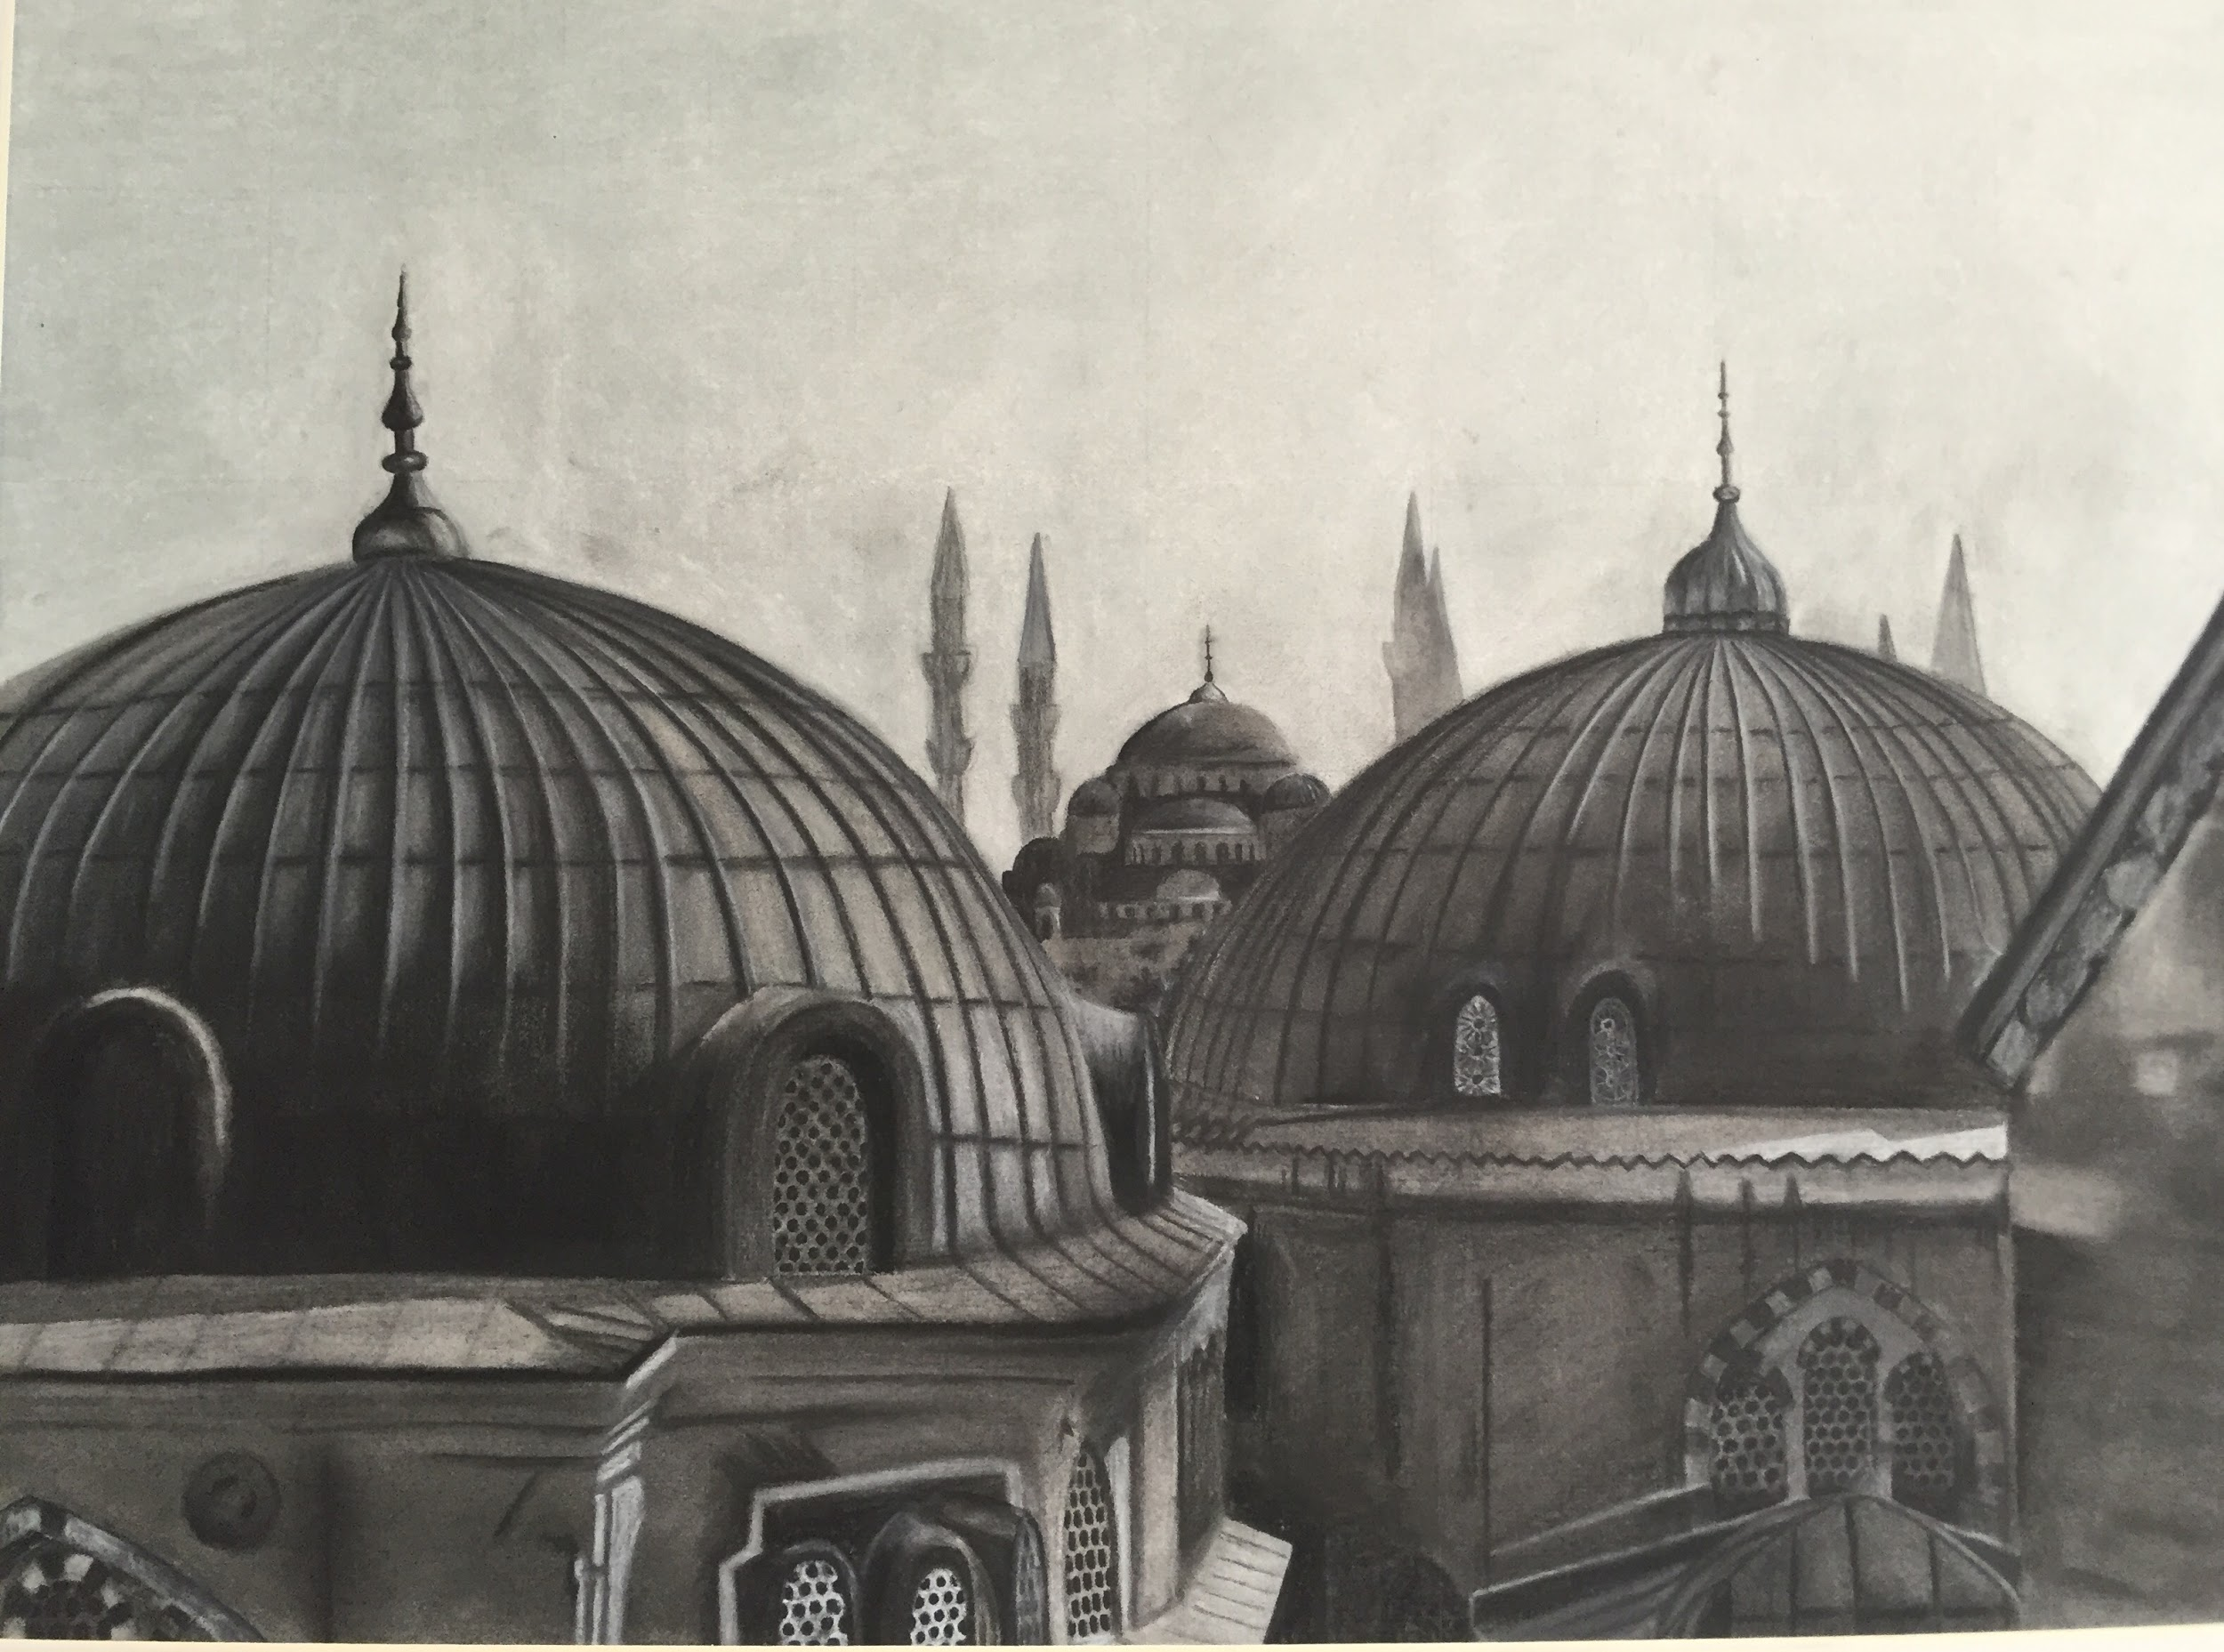
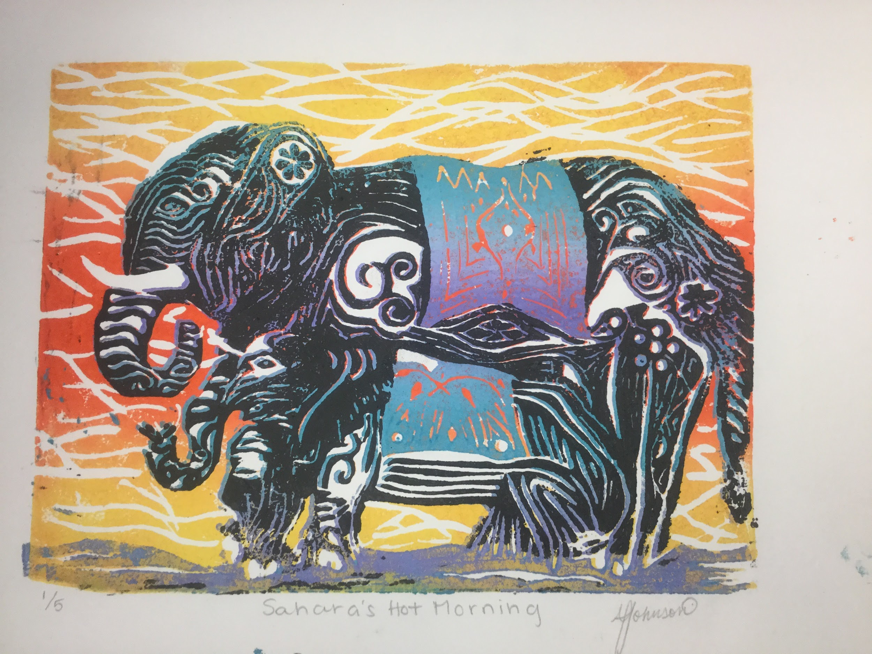
FINE ARTS AT MILLBROOK
HOMEBASE
Hear Mr. Davis talk about our art programs here at Millbrook High School in this video!
Notes:
Choose what you want for Arts… Its too much on their brochure honestly… Figure out if we want it

Slide 23
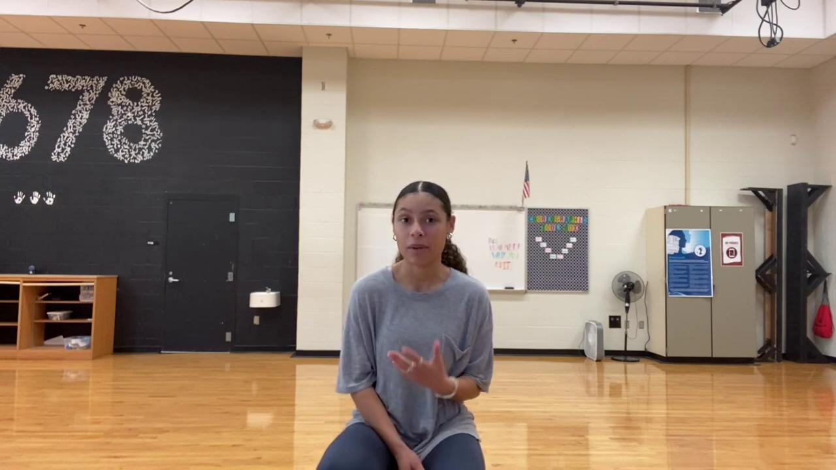
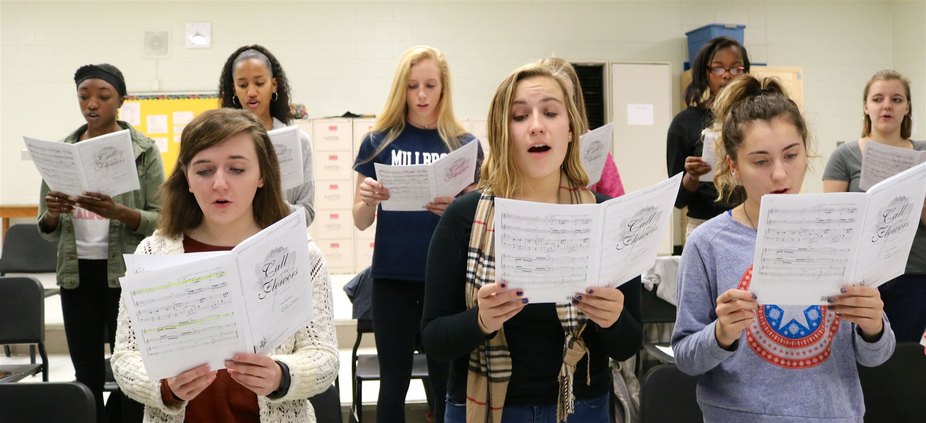
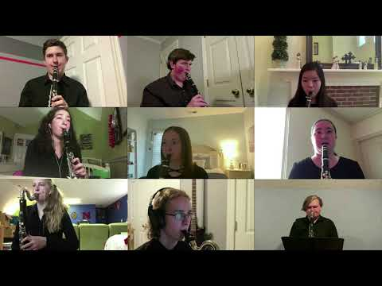
Performing Arts at Millbrook
HOMEBASE
Please click on a program photo below to hear more about it!
DANCE
CHORUS
BAND

Slide 24
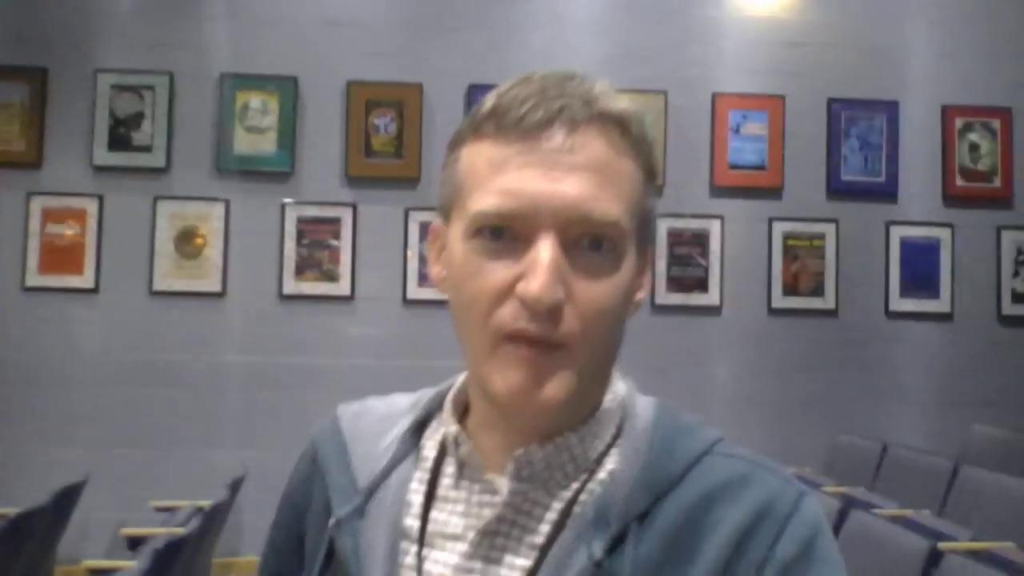
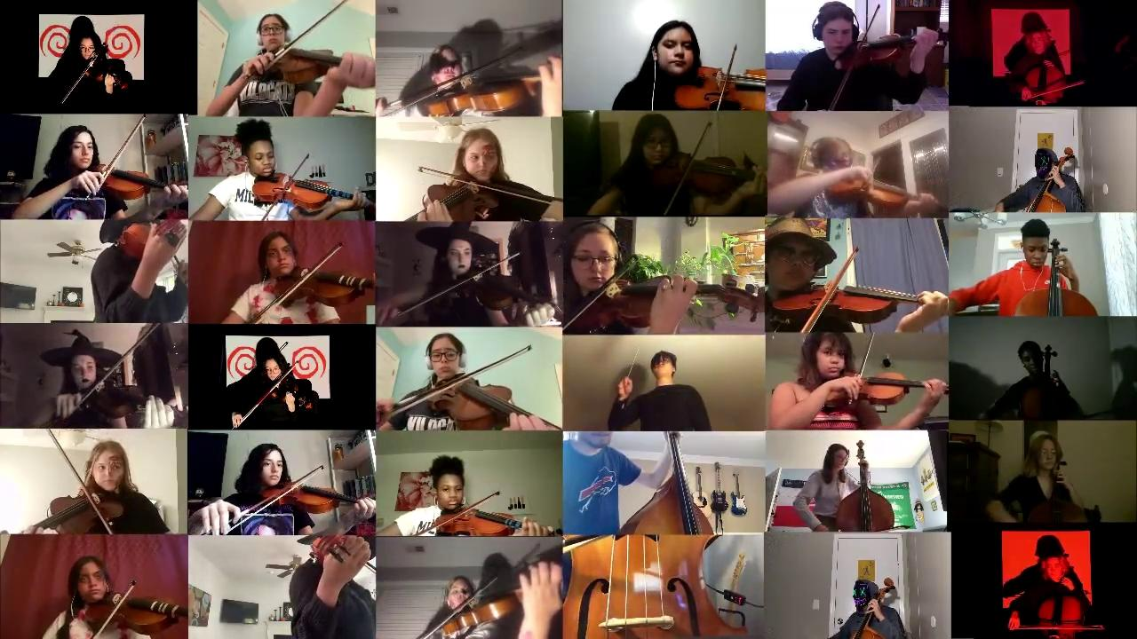
Theater
ORCHESTRA

Slide 25
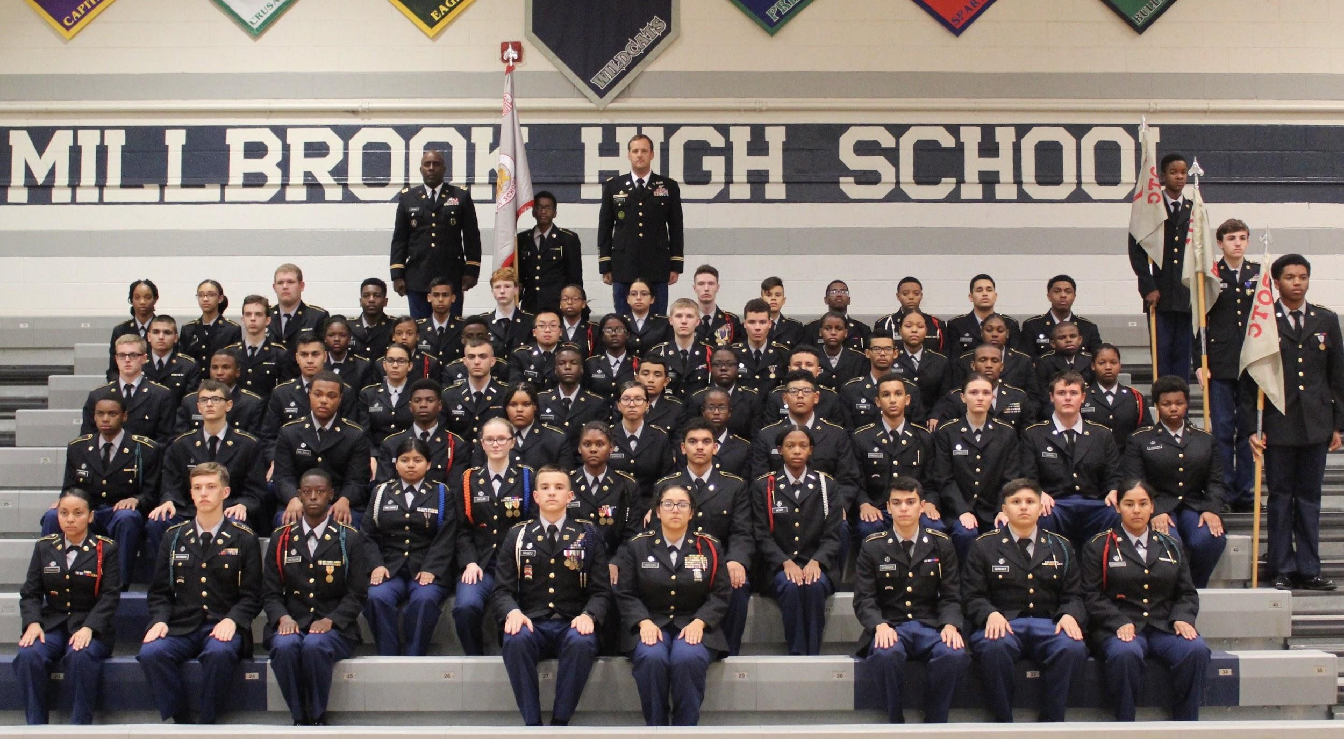
JROTC AT MILLBROOK
HOMEBASE
JROTC is a four year program in which cadets will receive instruction on leadership, followership, citizenship and many other positive characteristics. Additionally, they will reach new heights both mentally and physically as they grow in the program. At Millbrook, our Cadets are trained to not only meet, but exceed the existing standard, not only in the classroom, but in life also.
JROTC Mission
“To Motivate Young People To Be Better Citizens”

Slide 26
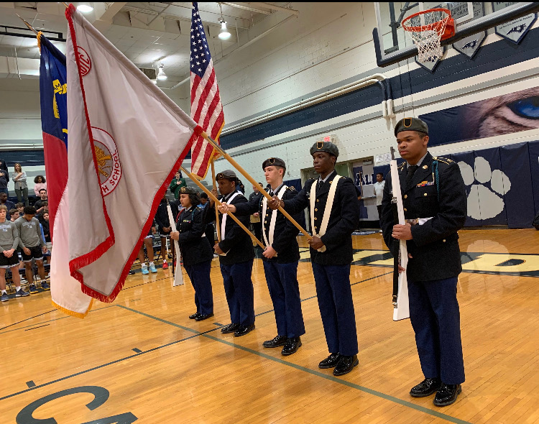
“JROTC greatly increased my social skills, as well as my physical fitness. Thanks to JROTC, I can now comfortably give a presentation, or introduce myself to new people. Physically, JROTC got me from not being able to do any push ups to doing nearly sixty in one minute!”. – Cadet Lieutenant Colonel McKimmon
HOMEBASE
“JROTC has helped me not just become a better leader and mentor, but it has helped me to become a better citizen, student, friend, and teacher to many people. I've learned that it's okay not to be the best but to give it your all no matter what.” – Cadet Master Sergeant Gevawer
JROTC Benefits
JROTC can be an appealing class on a college application.
Offers numerous chances to gain community service hours.
Improves physical fitness.
Provides Cadets the opportunity to participate on various competitive teams within the program.
To learn more please visit
millbrookhsjrotc.weebly.com
Comments or Questions
Please Contact
Army Instructor
Chief Warrant Three Hopper
ehopper@wcpss.net
Assistant Principal
Duane Flowers
dflowers@wcpss.net
“It’s hard to narrow it down to just a few, but JROTC has impacted me the most through my leadership skills, as well as my communication skills. When I started I was shy and scared to speak in front of small groups, now I know how to lead and set the example, as well as being able to speak in front of large crowds. ” – Cadet Major Gallop

Slide 27
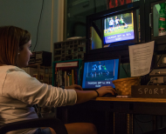
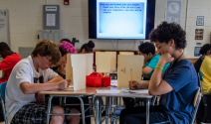
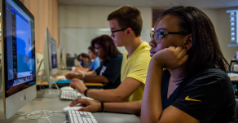
DIGITAL MEDIA CAREER ACADEMY AT MILLBROOK
What is a Career Academy?
a small learning community within a large comprehensive high school.
Students learn in smaller groups that help build multi-year relationships with teachers and other students.
Specialized classes teach the skills that students need to succeed in college and career.
Students can earn income while getting valuable job experience through their internships and summer jobs.
Career Academy students go to college more often than other students.

Slide 28
What are the benefits of the Digital Media Career Academy?
The Digital Media Academy provides students access to:
Goals
To equip students with personal, analytical, technical and communication skills necessary to be successful in today’s professional and academic arenas.
To introduce students to the many career opportunities within the digital world.
To provide a new context for learning through building motivation and a sense of personal worth.
To increase academic and personal achievement.
Integrated learning environments
A wide variety of technology resources
Business and industry expertise through:
- Presentations, demonstrations and seminars
- Field trips
- Job shadowing
- Mentoring
- Internship

Slide 29
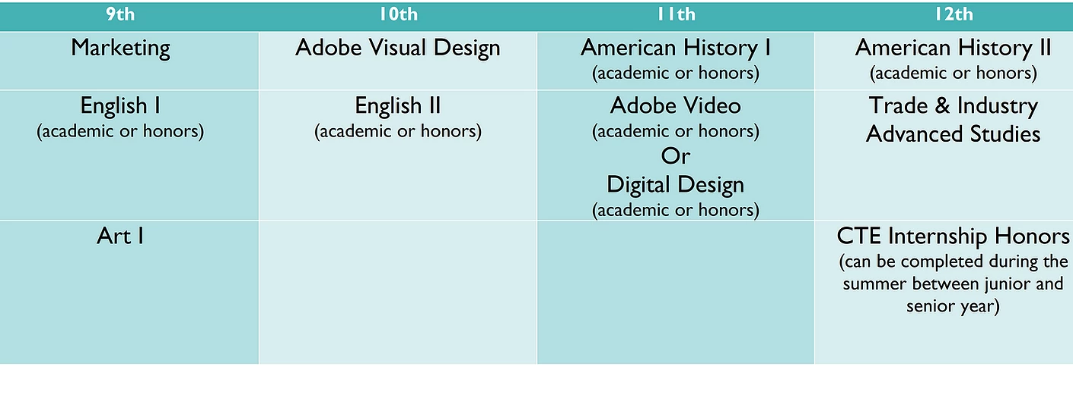
DIGITAL MEDIA CAREER ACADEMY AT MILLBROOK
Courses & Enrollment

Slide 30
CONTACT INFORMATION:
Dana Kaushik, Career Academy Coordinator dkaushik@wcpss.net
919.850.8787 ext 21420
Jenny Cahoon, Counselor
jcahoon@wcpss.net
919.850.8836
Visit MHS Digital Media website:
https://mhsdmca2014.wixsite.com/mhsdmca2014

Slide 31
SCHEDULE
HOMEBASE
Regular Day
Millbrook operates on an A/B schedule with four, 90-minute classes per day
There are 3 lunches, w/ off-campus lunch privileges for Seniors and Juniors
Class | Time
1st Block | 7:25-8:55 am
2nd Block | 9:00-10:33 am
3rd Block | 10:33-12:43 pm
1st Lunch | 10:33-11:08 am
2nd Lunch | 11:20-11:55 am
3rd Lunch | 12:08-12:43 pm
4th Block | 12:48-2:20 pm

Slide 32
TRADITIONAL ACADEMICS AT MILLBROOK
HOMEBASE
Over four years at Millbrook High School, students will complete all requirements for Graduation. In their first two years, all students complete the IB Middle Years programme by taking courses in:
Language and Literature (English)
Humanities (History)
Math
Science
Healthful Living
Fine and Performing Arts
Career and Technical Ed
Additionally, students in 9th and 10th grade may opt to take Advanced Placement (AP) courses in their core academic areas.
Continue to more Academics
Notes:
Courtney Chance and Aziz videos

Slide 33
11th and 12th grades
HOMEBASE
In 11th grade, students can opt to join the IB Diploma Programme (DP); an inclusive, rigorous program that challenges students to grow across every academic area. Students who do not participate in the DP can still take a variety of AP courses and participate in the rich programming in the Arts and in Career and Technical Education.
Diploma Programme students take courses 2-years in length in 6 different areas and participate in AP, Arts, and elective courses.
Language and Literature
Language Acquisition
Math
Science
Humanities
IB Elective (Film, Theater, World Religions, etc)

Slide 34
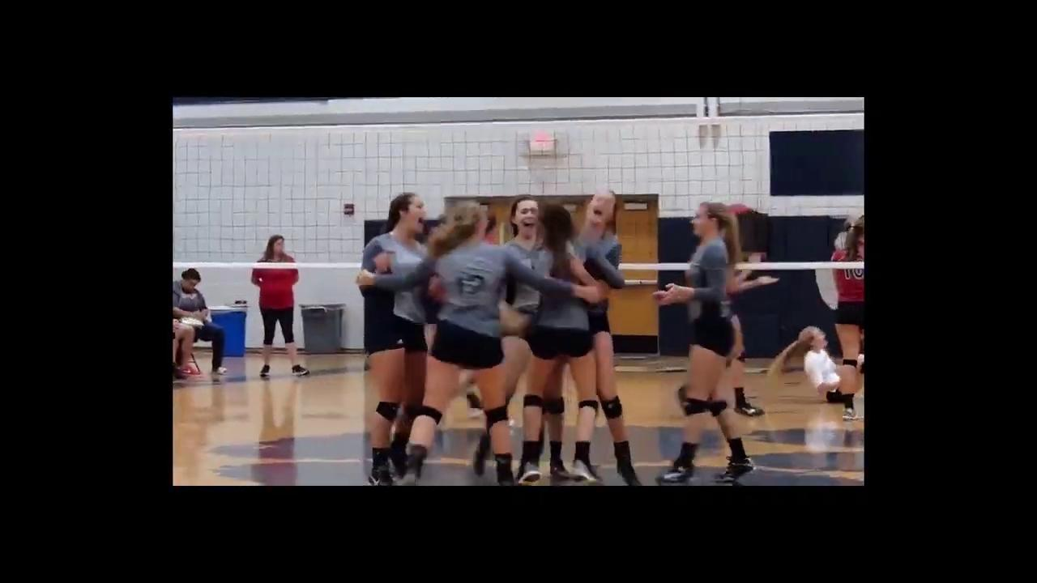
LIFE AT MILLBROOK - Athletics
HOMEBASE
Millbrook has a tradition of academic and athletic excellence.
https://www.wakecountyathletics.com/millbrookhs
Notes:
Add videos Athletic and activities

Slide 35
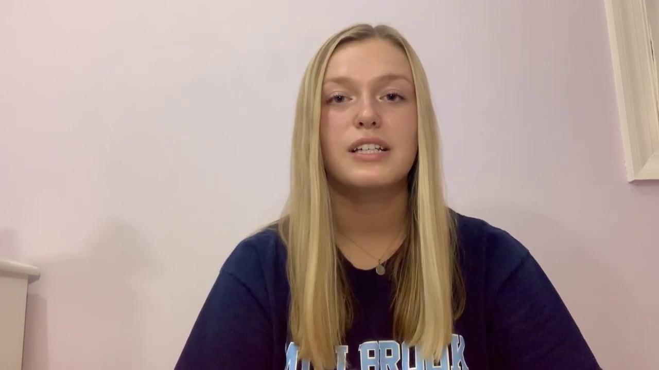
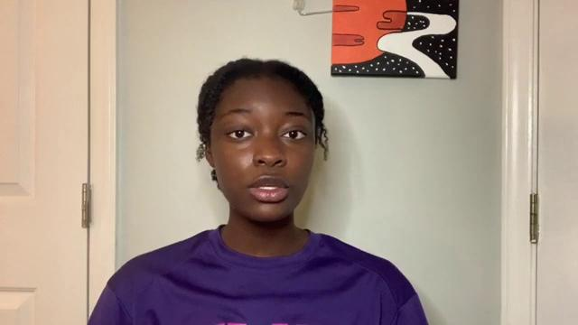
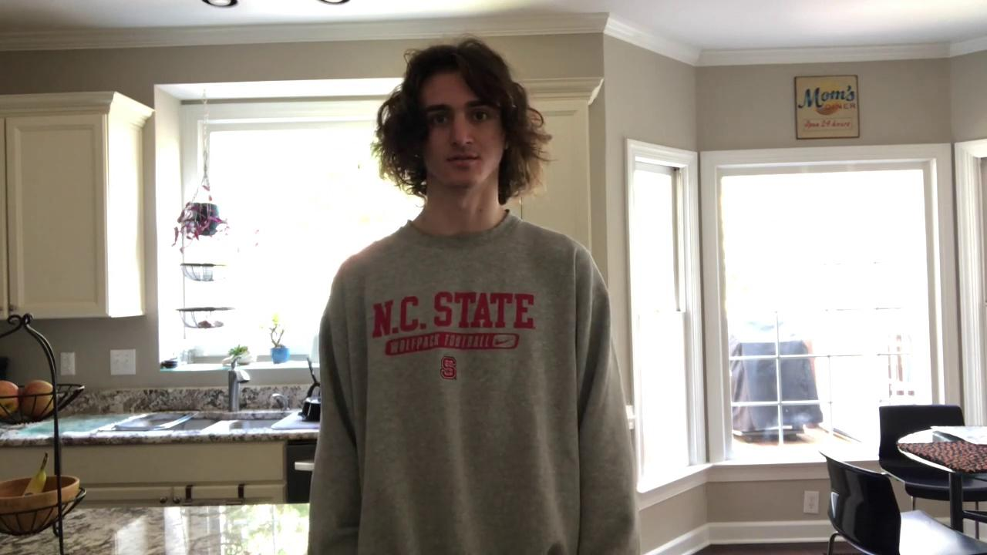
LIFE AT MILLBROOK - Our Athlete’s Voices
Athletics Page
HOMEBASE
Millbrook has a tradition of academic and athletic excellence.
Meet Haley, Aminata, and Michael- 3 student athletes here, at Millbrook
Notes:
Add videos Athletic and activities

Slide 36
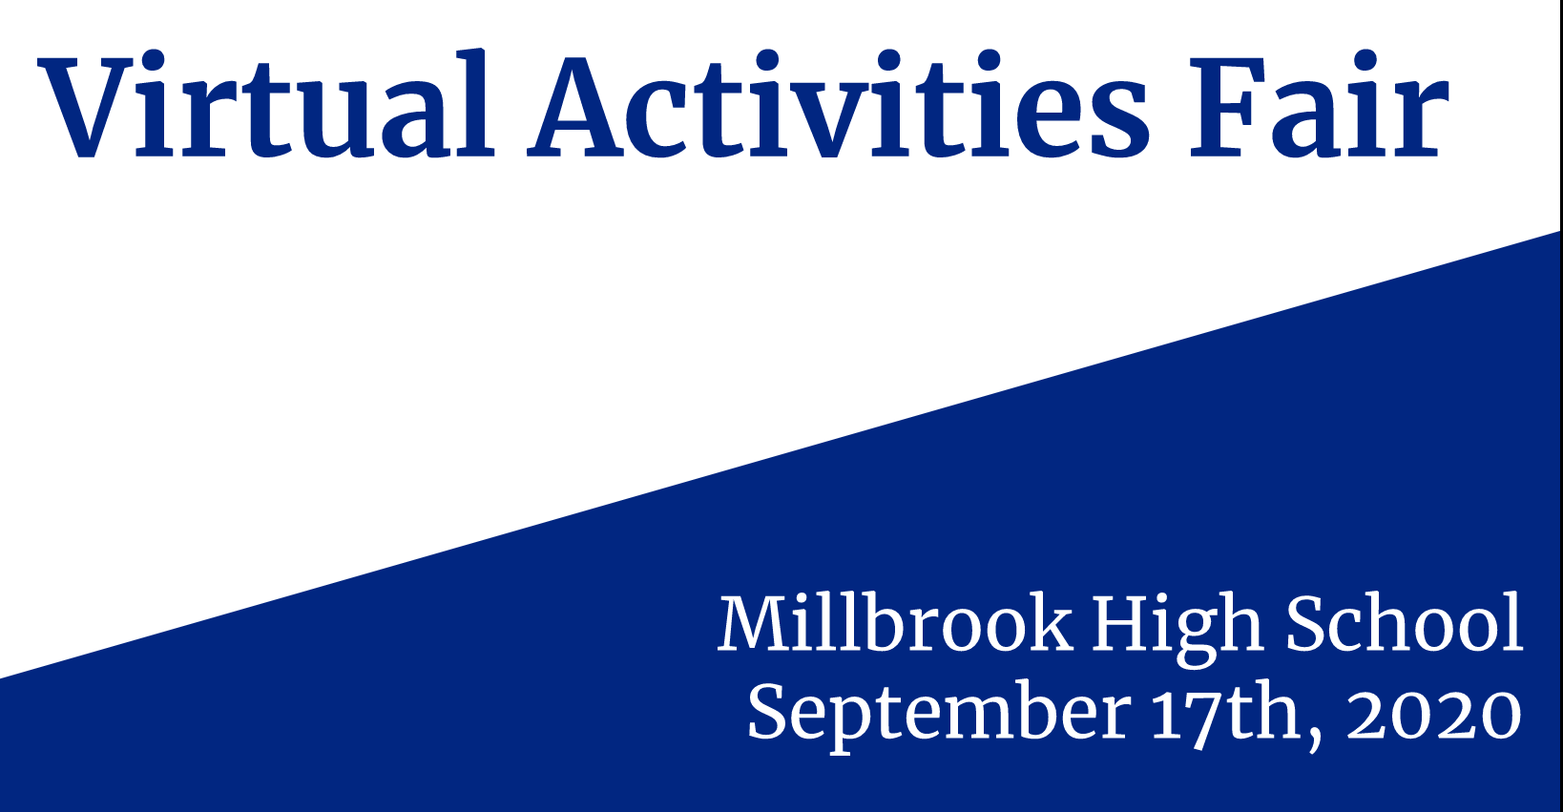
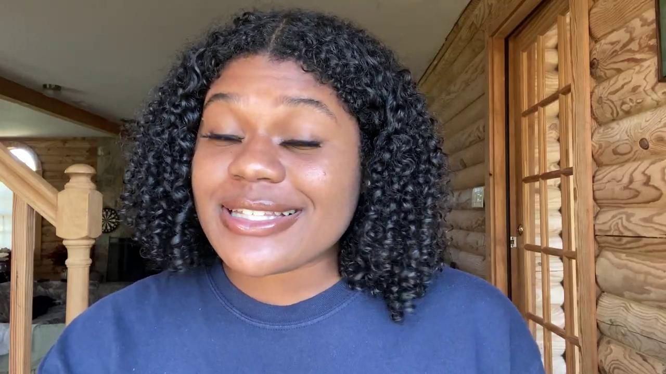
LIFE AT MILLBROOK- Clubs and Activities
HOMEBASE
Student life at Millbrook consists of various clubs and activities. With the variety of clubs offered, you can find the place that fits YOU!
Cierra, current Student Body President
Notes:
Activities video

Slide 37
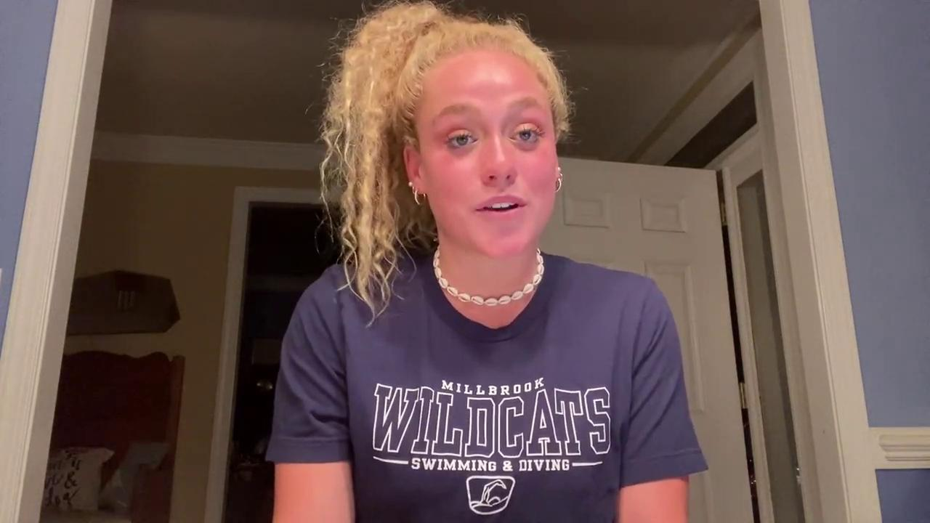
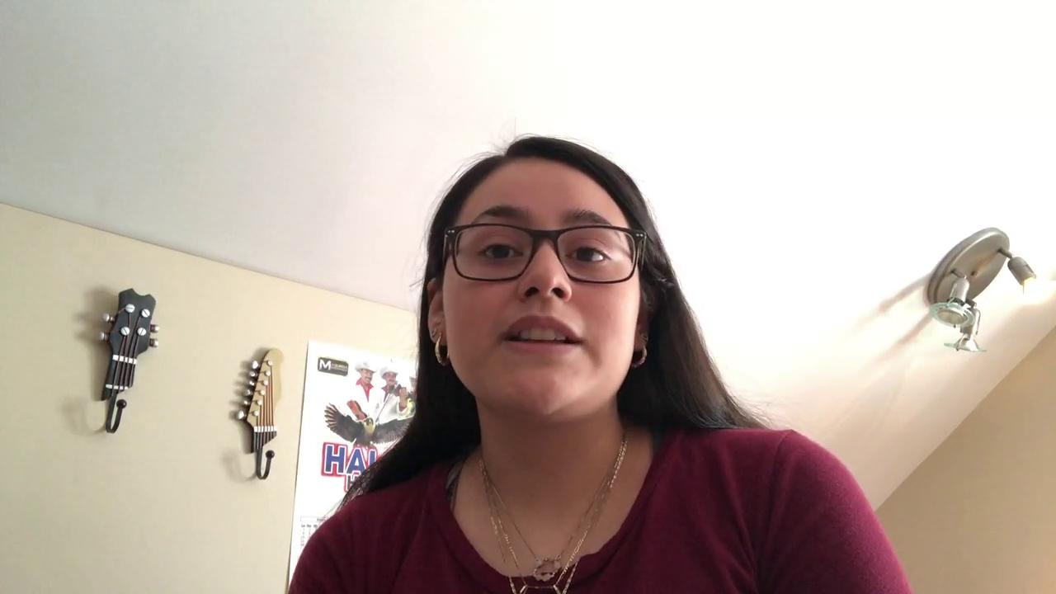
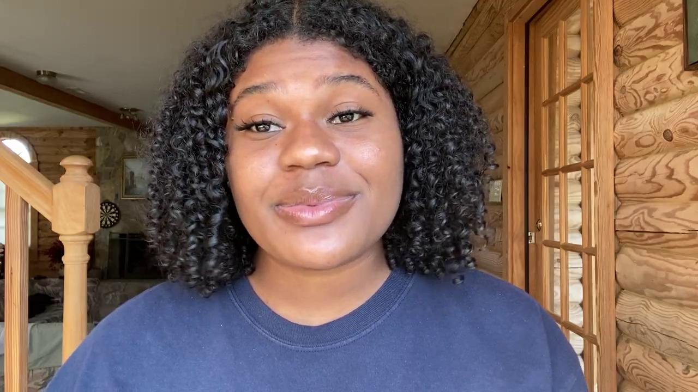
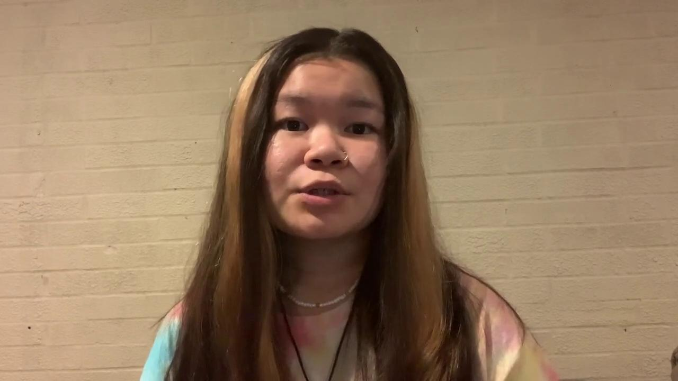
LIFE AT MILLBROOK- Clubs and Activities
HOMEBASE
Hello from Janie, Cierra, Jennifer O, and Jennifer T- 4 student leaders here at MHS
Notes:
Activities video

Slide 38
How to Apply
HOMEBASE
Magnet/Year- Round Application Period:
October 15, 2020- January 28, 2021
You can read more about the application process here:
WCPSS Magnet Information

Slide 39
Upcoming Events
HOMEBASE
https://millbrookib.weebly.com/recruitment-eventsvirtual-tours.html
Q and A Sessions
Theme: What to Expect- IB (MYP and DP) Curriculum
November 12th- 5:30 PM and 9:00 PM
November 13th- 9:15 AM and 1:00 PM
Theme: Offerings at Millbrook- Traditional Academics and other Opportunities?
December 7th-9:15 AM and 1:00 PM
December 8th-5:30 PM and 9:00 PM
January 7th TBA- Millbrook Current Student/Parent Reflections and FAQ
January 12th- 5:30 for current East and West Millbrook Magnet Students and Families
January 26th- 5:30 for current Carroll Middle School Magnet Students and Families
January 27th 5:30- for Current Private and Charter School Families
May 6th- Q&A New Parent reflections
Events
IB Expo:
January 12, 2020, 6:30
Come and experience the principles and practices of Millbrook's Middle Years and Diploma Programmes. Discuss the programmes with current staff and students and see the quality work they have produced
Notes:
https://millbrookib.weebly.com/recruitment-eventsvirtual-tours.html
Haddock

Slide 40
Thank You!
HOMEBASE
Thanks for taking time to discover Millbrook. For more information or to sign-up for recruitment events, please visit the following:
https://millbrookib.weebly.com/
Contact Information
Loren Baron
Diploma Programme
Coordinator
(919)850.8787, Ext 21426
lbaron@wcpss.net
LaShonda Haddock
Middle Years Programme
​Coordinator
(919)850.8787, Ext 21414
lhaddock@wcpss.net
Charles Patton
Assistant Principal
(919)850.8787, Ext. 21468
cpatton2@wcpss.net
Music by: Benjamin Tissot

